Slide 1
Jessica Kohout
Reservoir High School, US
jessica_kohout@hcpss.org
@MrsKohout
Kevin Spry
Texas Instruments
kspry@ti.com
@kspry

Slide 2
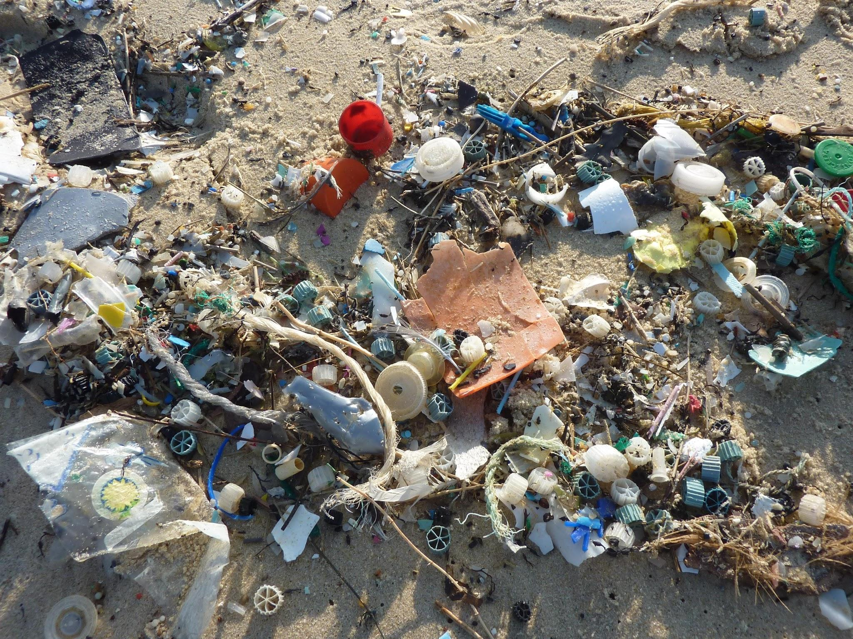
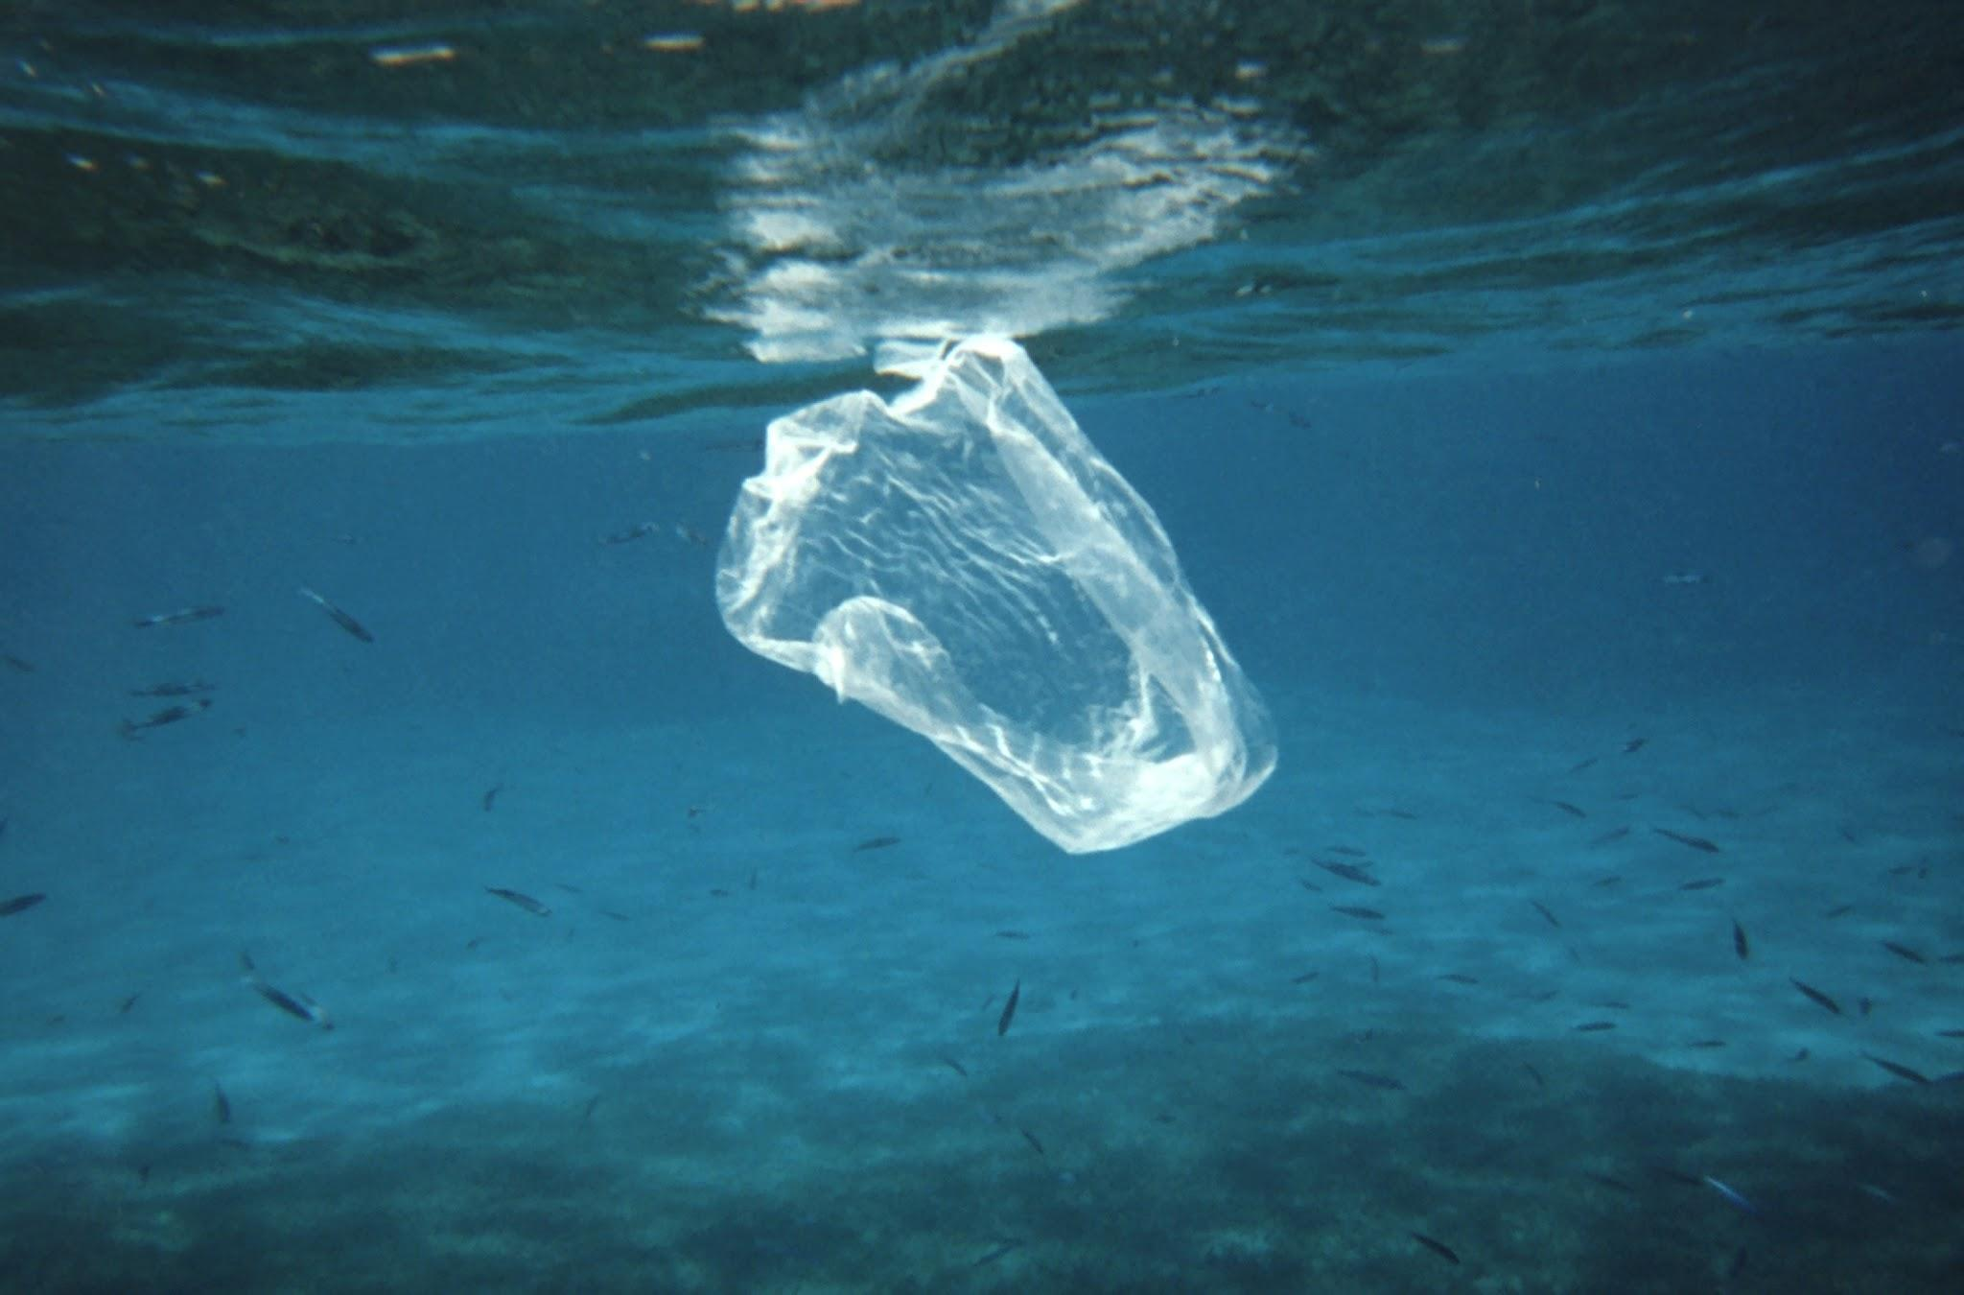
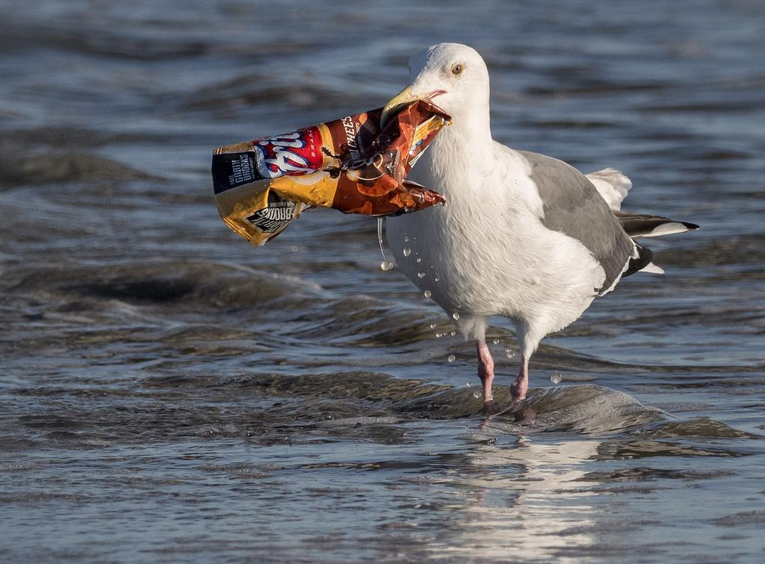
Who is Drowning in our Trash?

Slide 3
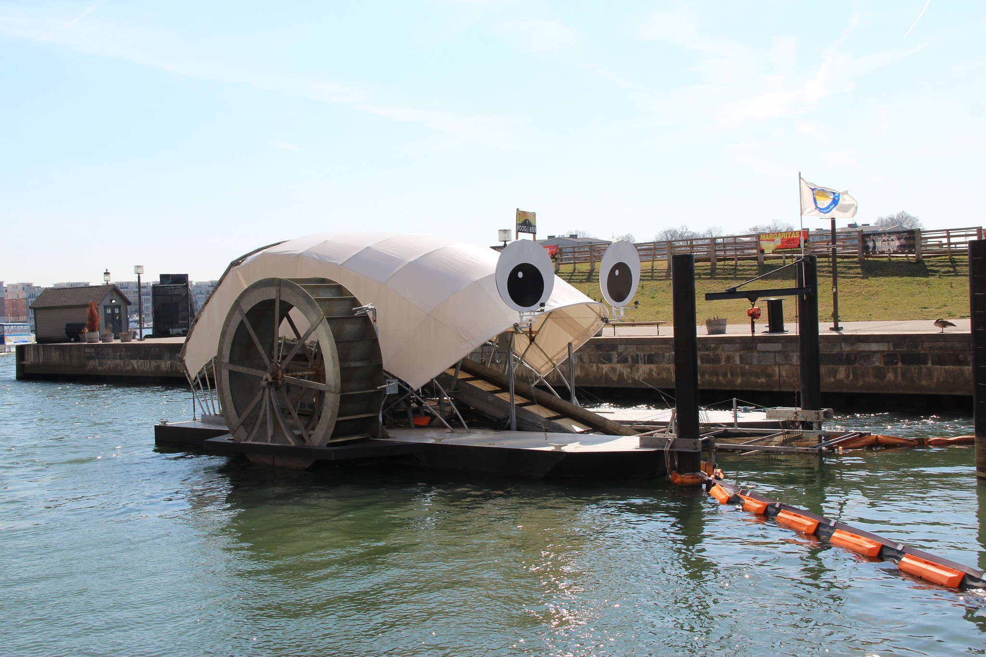
Mr. Trash Wheel:
What is it and what does it do?
Mr. Trash Wheel and friends use the water currents and solar power to clean waterways leading to the Baltimore Harbor and the Chesapeake Bay.
Invented by John Kellett of ClearWater Mills in 2007 after noticing the amount of trash floating in the water on his way to work.
Mr. Trash Wheel was officially launched in 2014 and has picked up as much as 38,000 lbs of trash in a single day!
Owned and Maintained by Waterfront Partnership

Slide 4
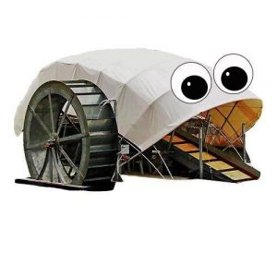
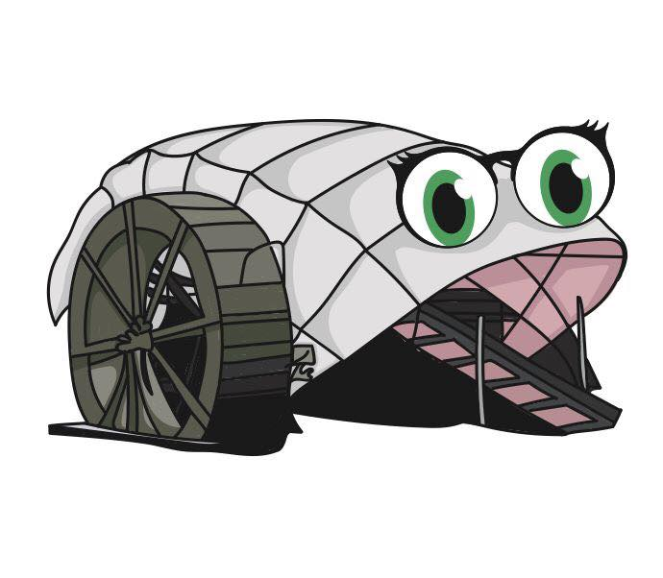
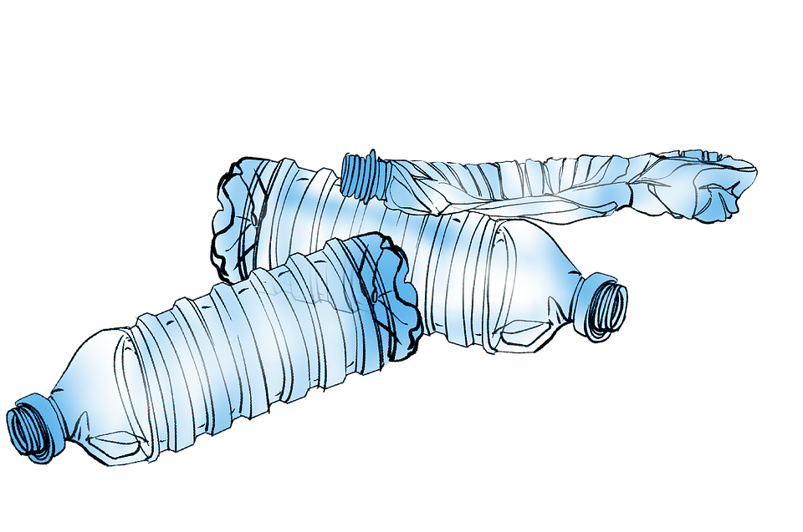
Trash Wheels
@MrTrashWheel
@ProfTrashWheel
Using STEM to connect to real-world problems
@CaptTrashWheel

Slide 5
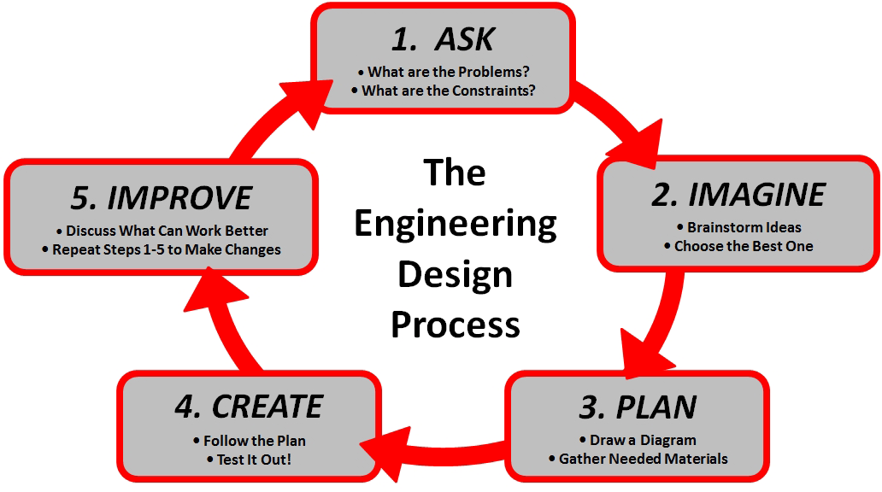
The Engineering Design Process

Slide 6
Bringing Awareness - What is the Problem?
What students were learning:
The human impact of plastics in their environment
Individual student tracking of their single-use plastics consumption over five days
Participated in a campus clean up and tallied the type of trash and quantity, then they graphed the data

Slide 7
Engineering Design & Coding Connection
Problem: How do we reduce the amount of trash that gets into our oceans?
Requirements:
Build a model of a trash interceptor that will remove waste from a waterway.
The model must be made of upcycled single-use plastics
The model must move a piece of trash (ping pong ball) from a water source to a seperate container outside of the water.
The model must include splash resistant protections for the sensors and electronics used.
Create a 60 second PSA video to showcase your model and bring awareness of the effects of single-use plastics on local waterways and wildlife.
Bonus: Create a way to automatically activate your trash interceptor when trash is present and turn off when trash is not present.

Slide 8
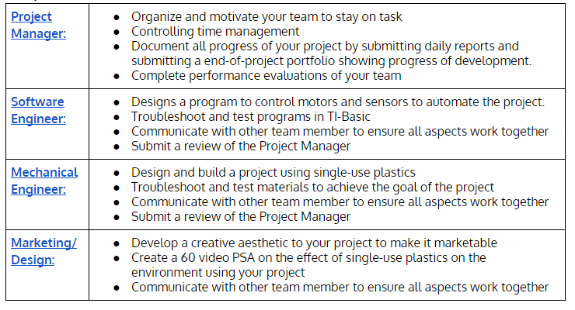
Group Roles for both Right/Left Brains

Slide 9
Timeline:
Day 1 | Introduction to Trash Wheel & Post-It note brainstorming
Day 2 | Share out ideas and sort into categories. Discuss possibilities/problems
Day 3 | Concept Sketch: Draw out ideas. What do you want to? How can you get this to work? Share out ideas
Day 4 | Peer-Review sketches & Introduce group roles
Day 5-8 | Build and test
Day 9 | Gallery Walk/Peer Review

Slide 10
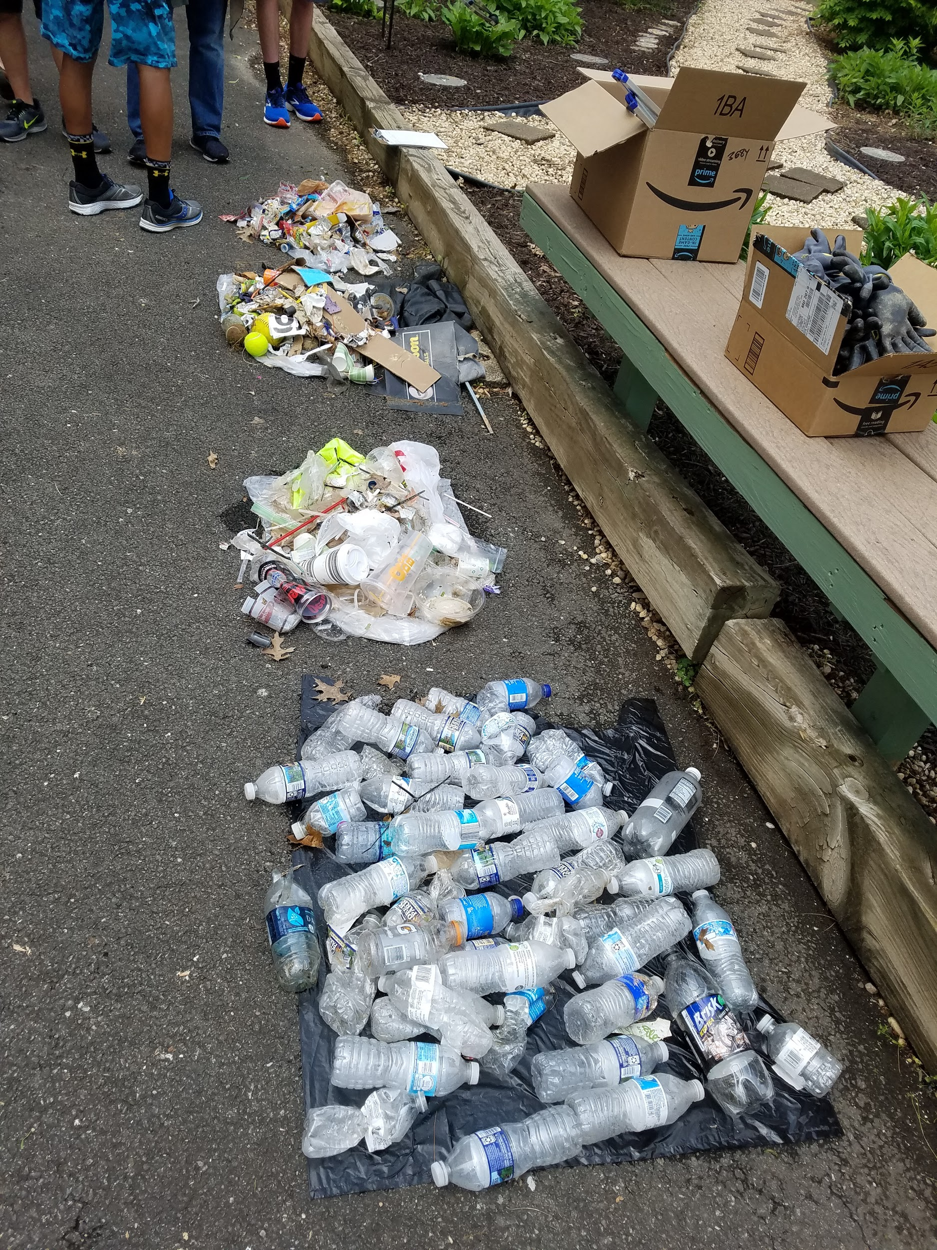
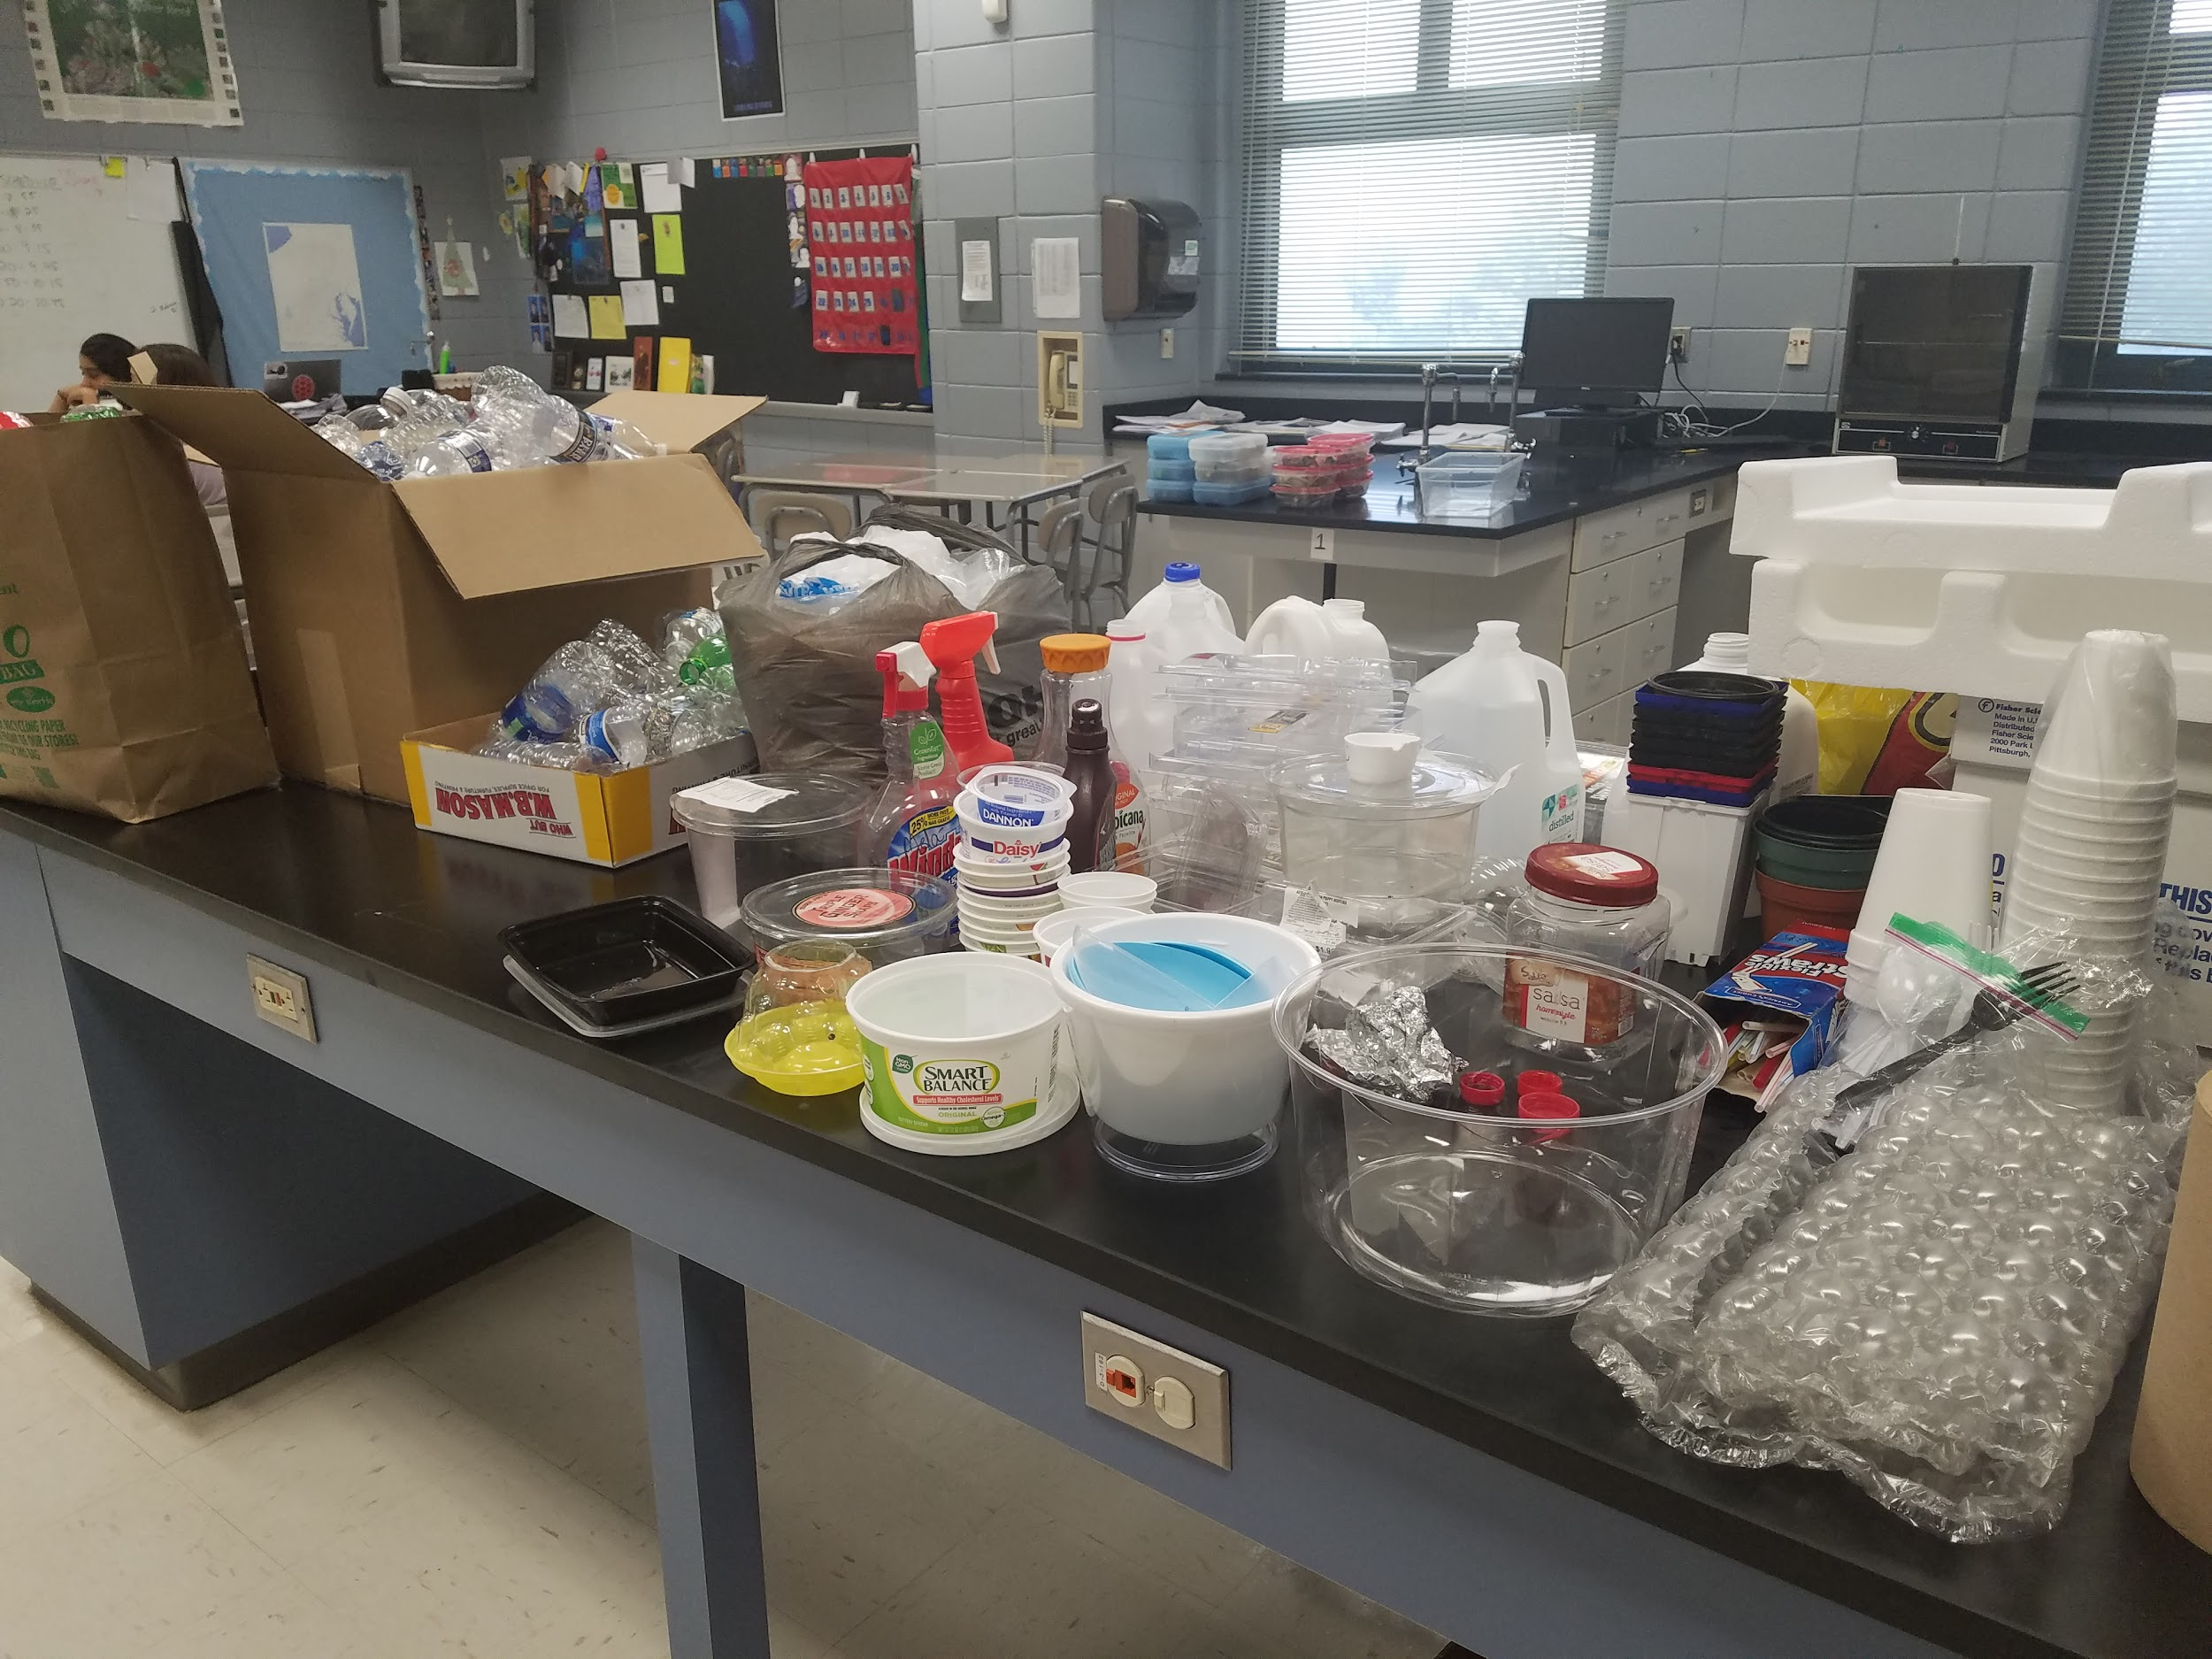
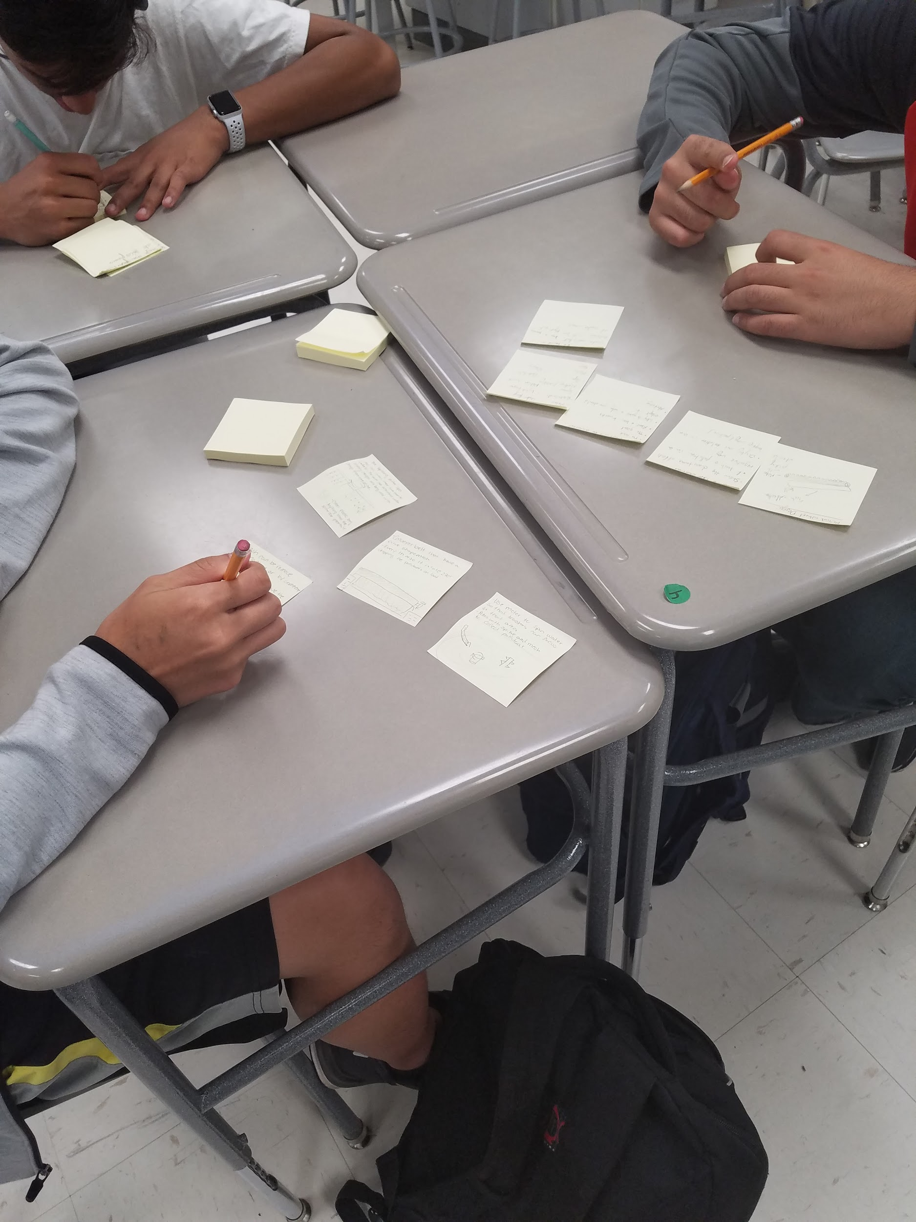
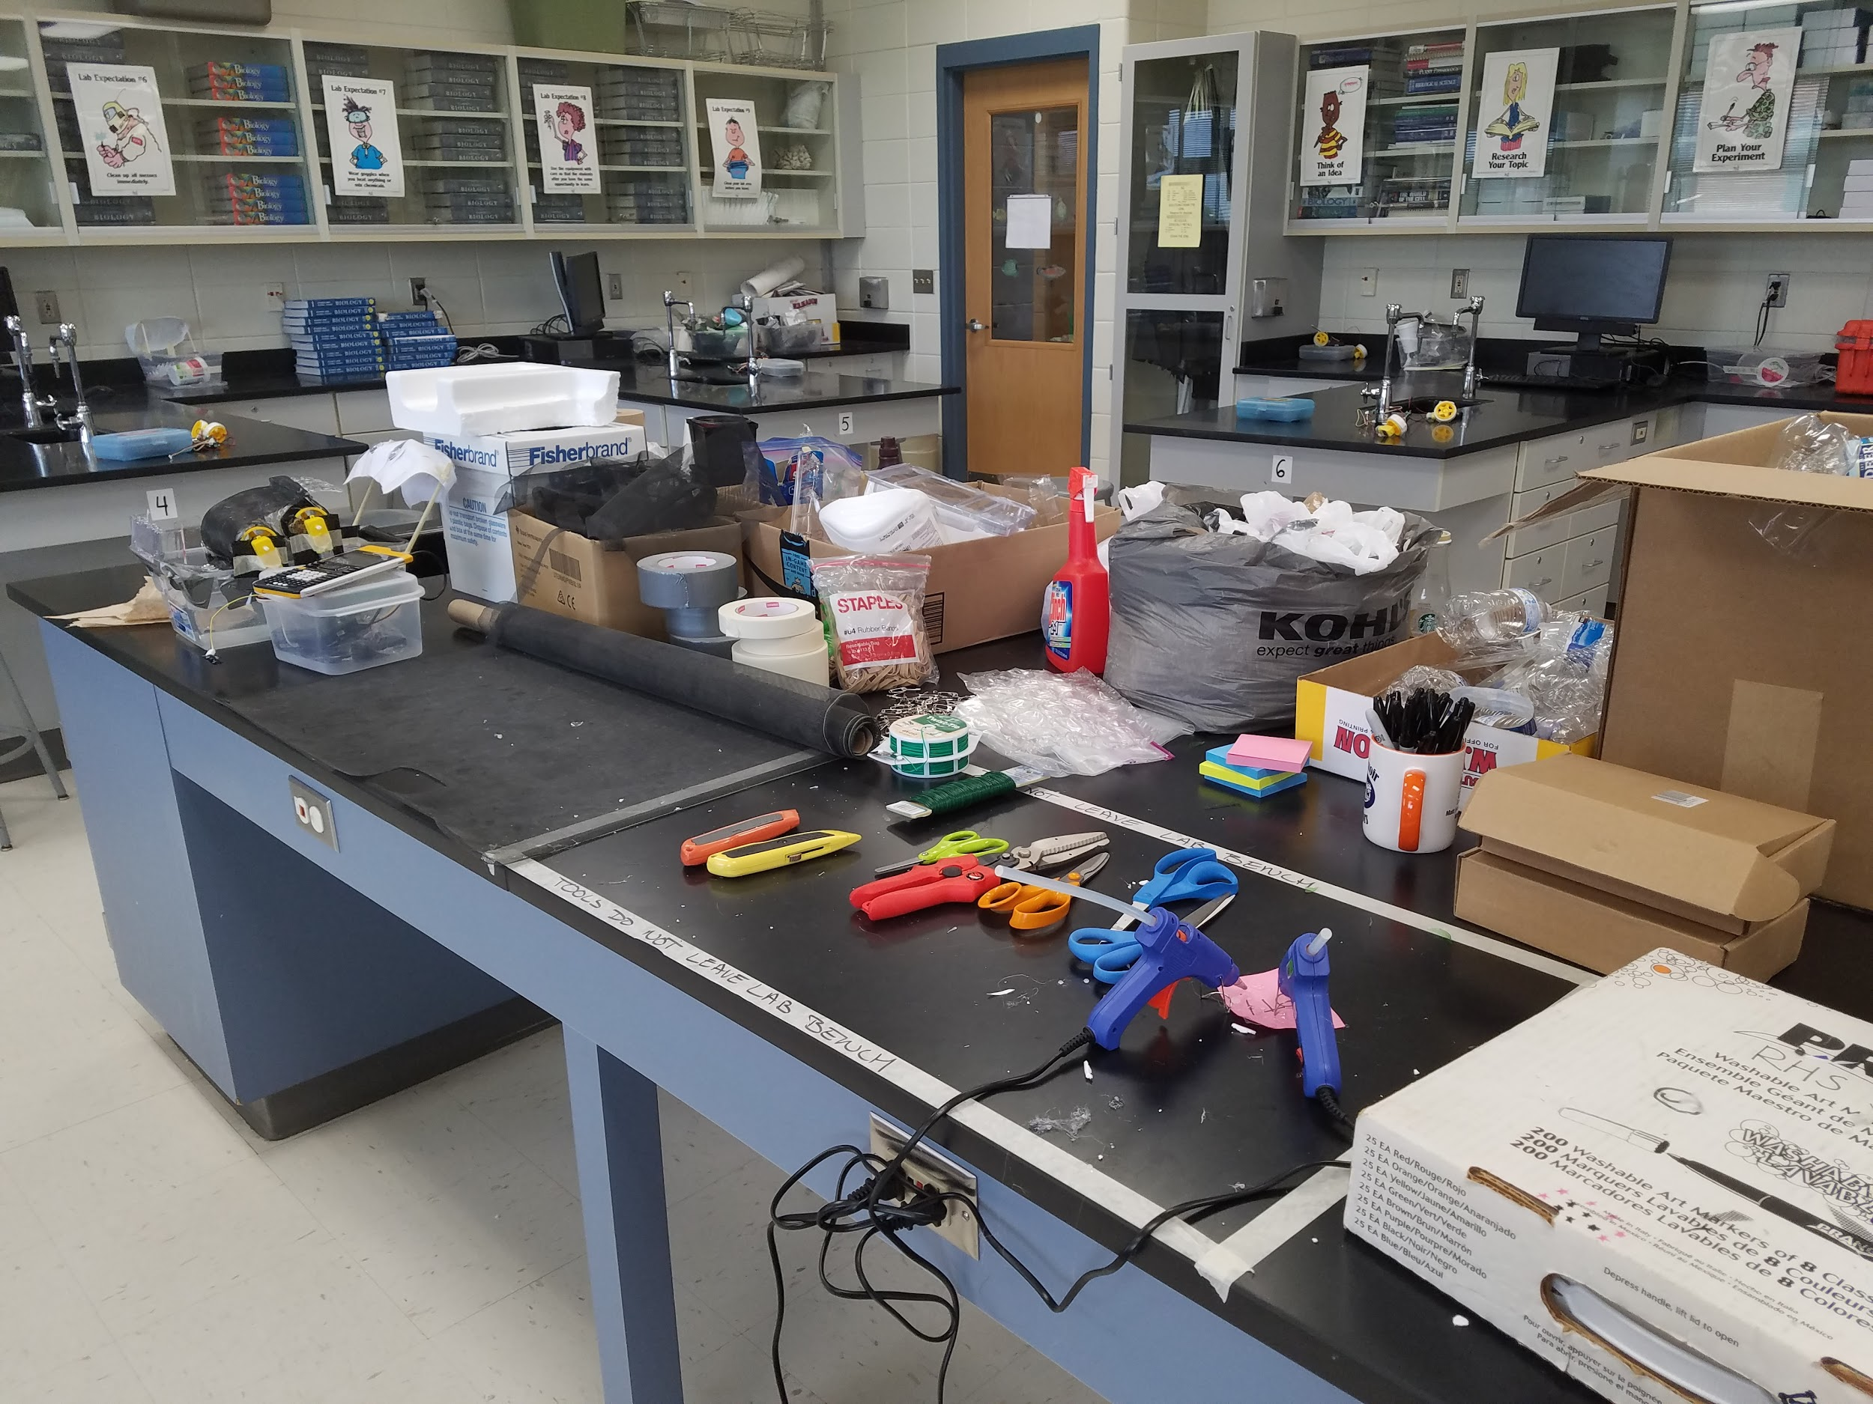
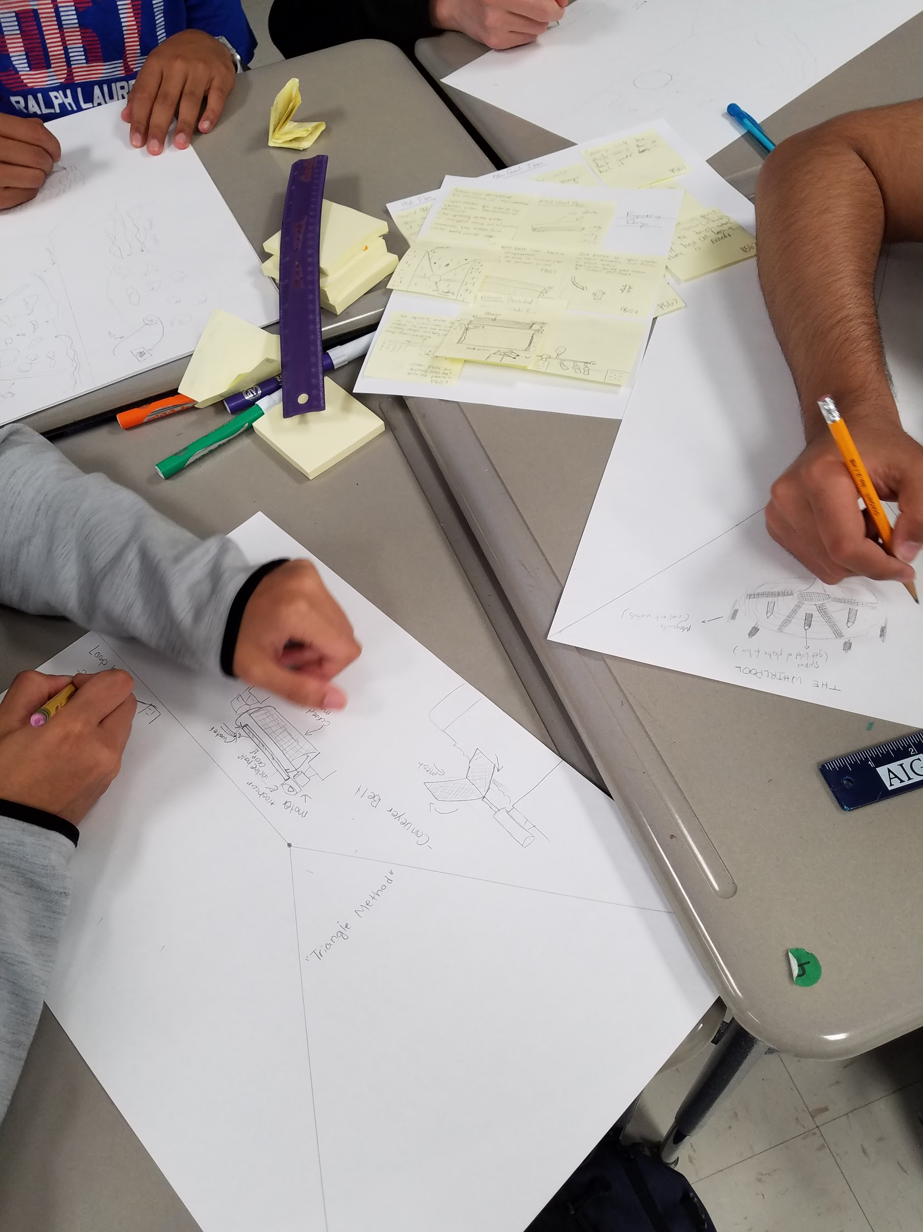
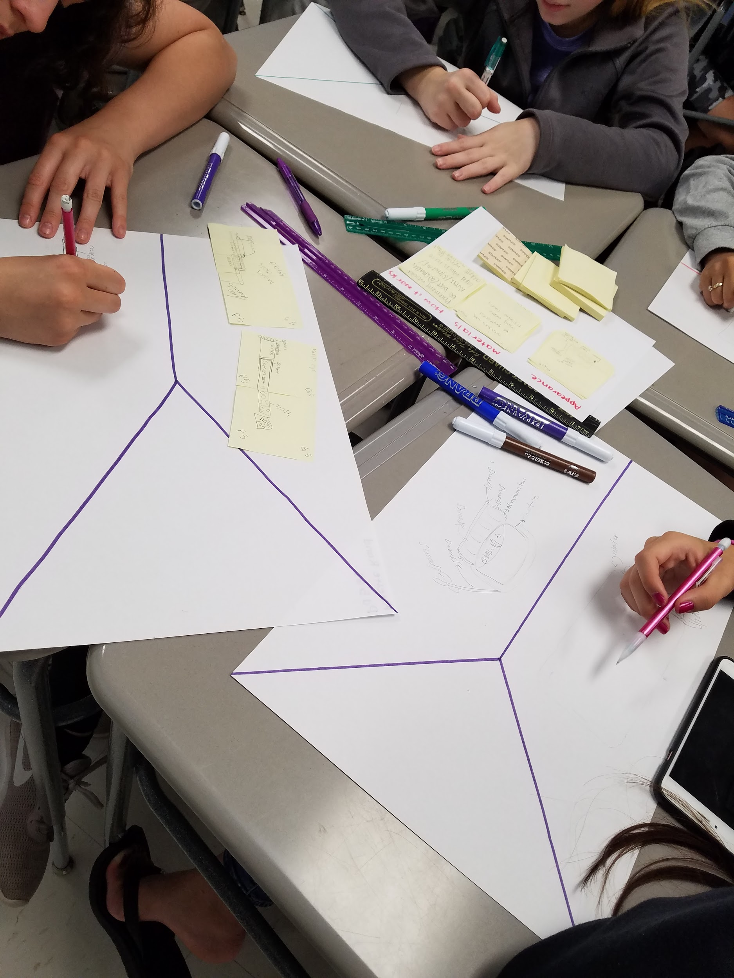
Student Progress

Slide 11
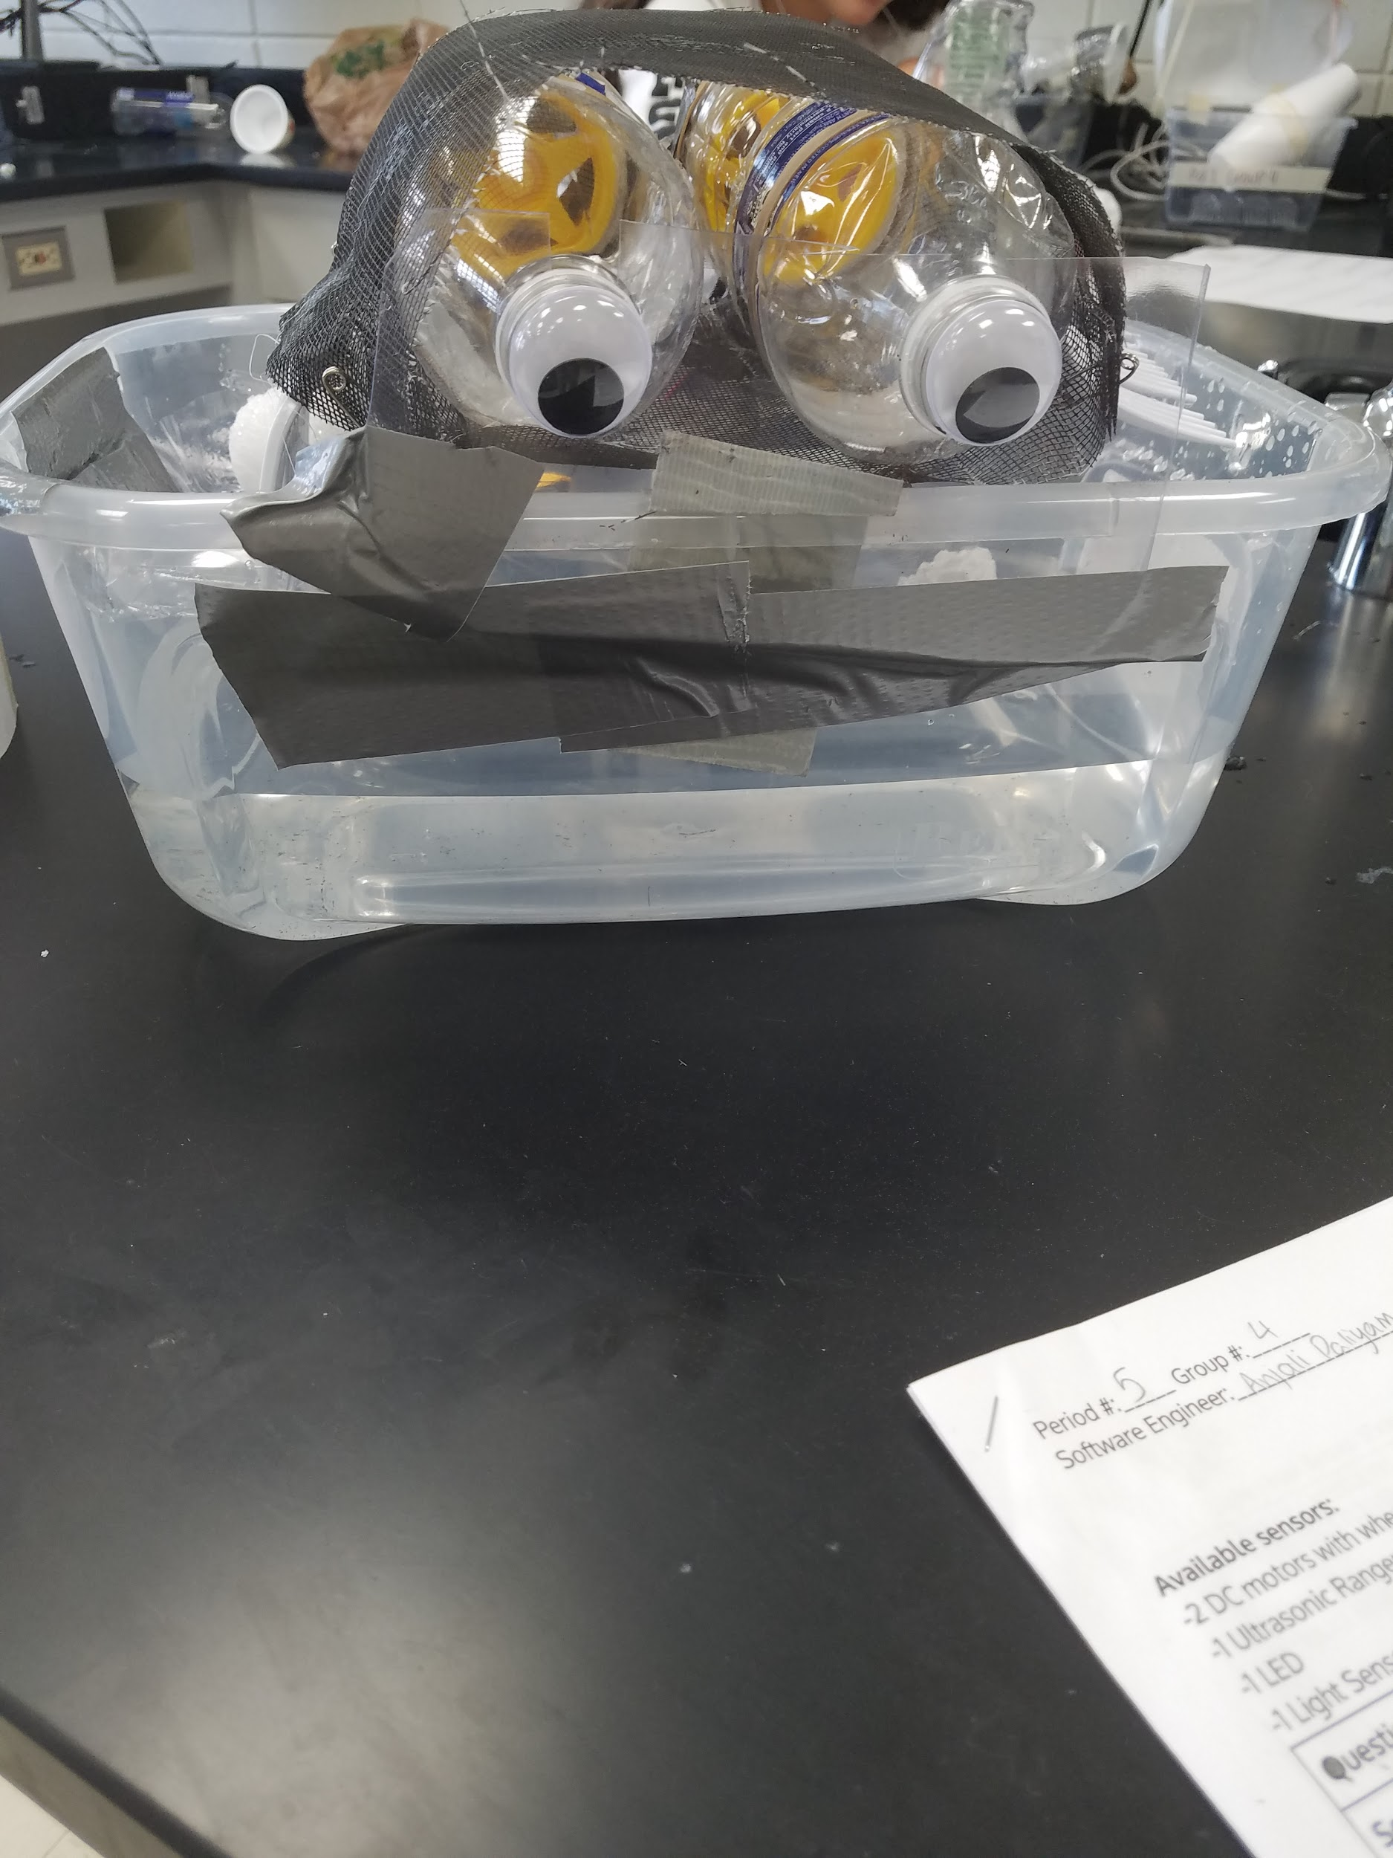
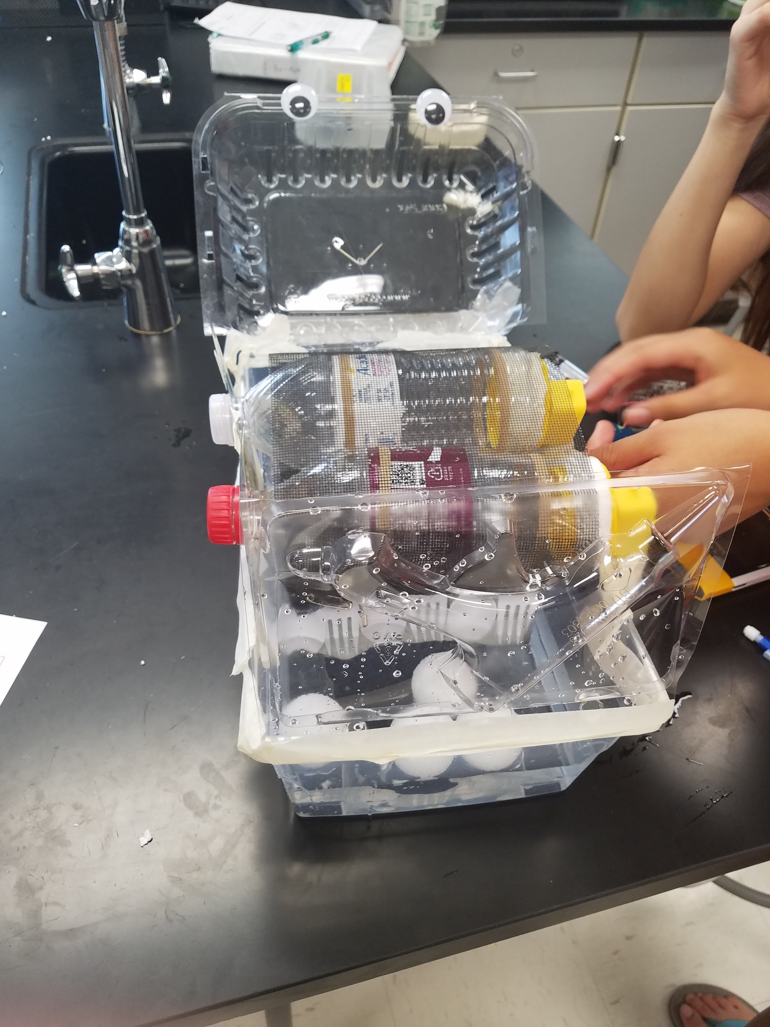
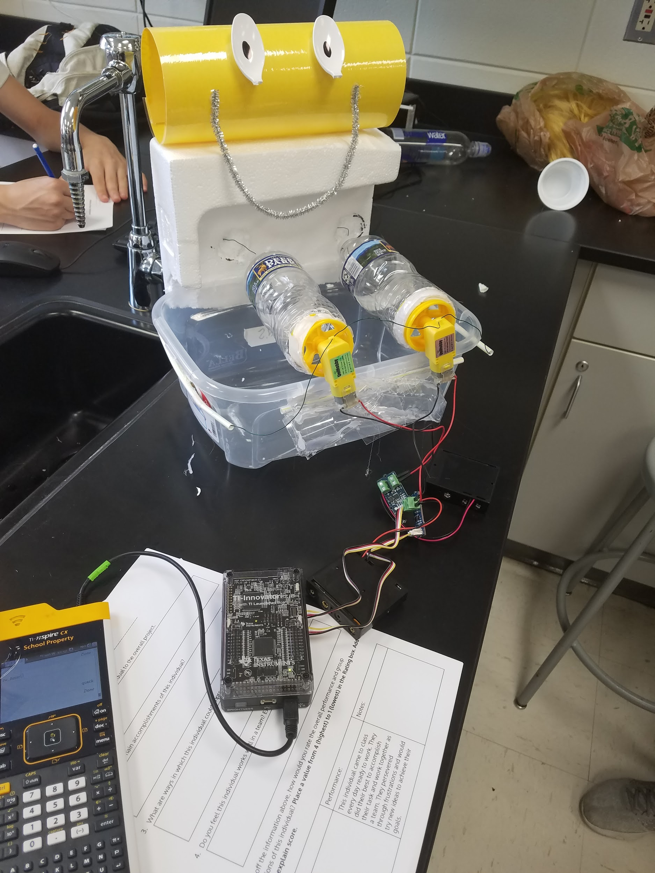
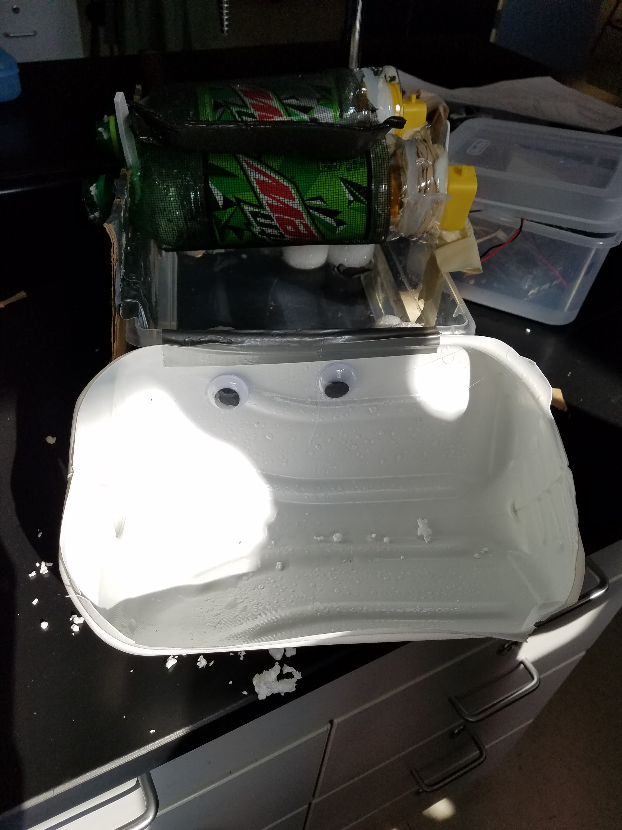
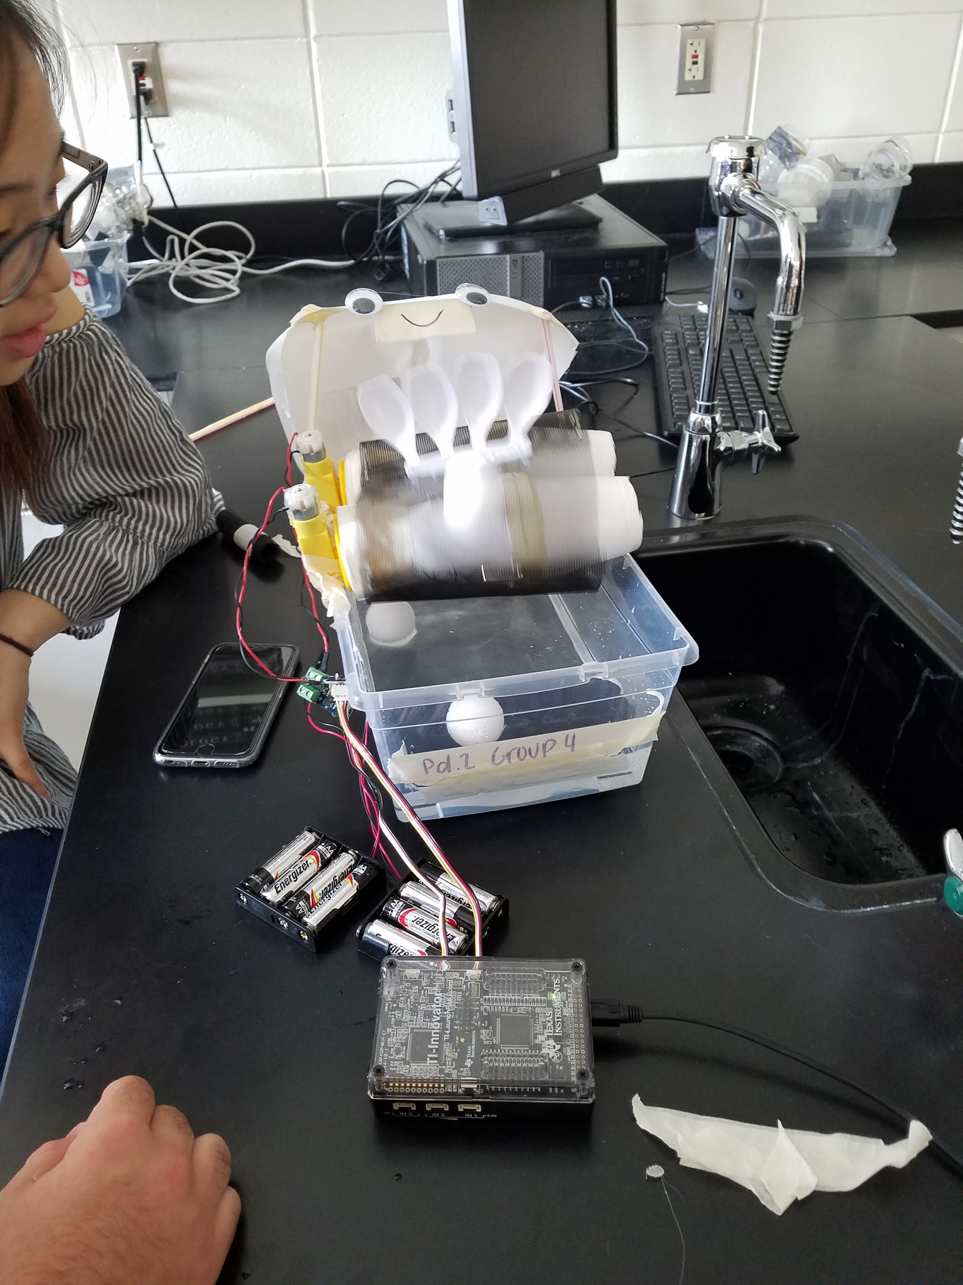
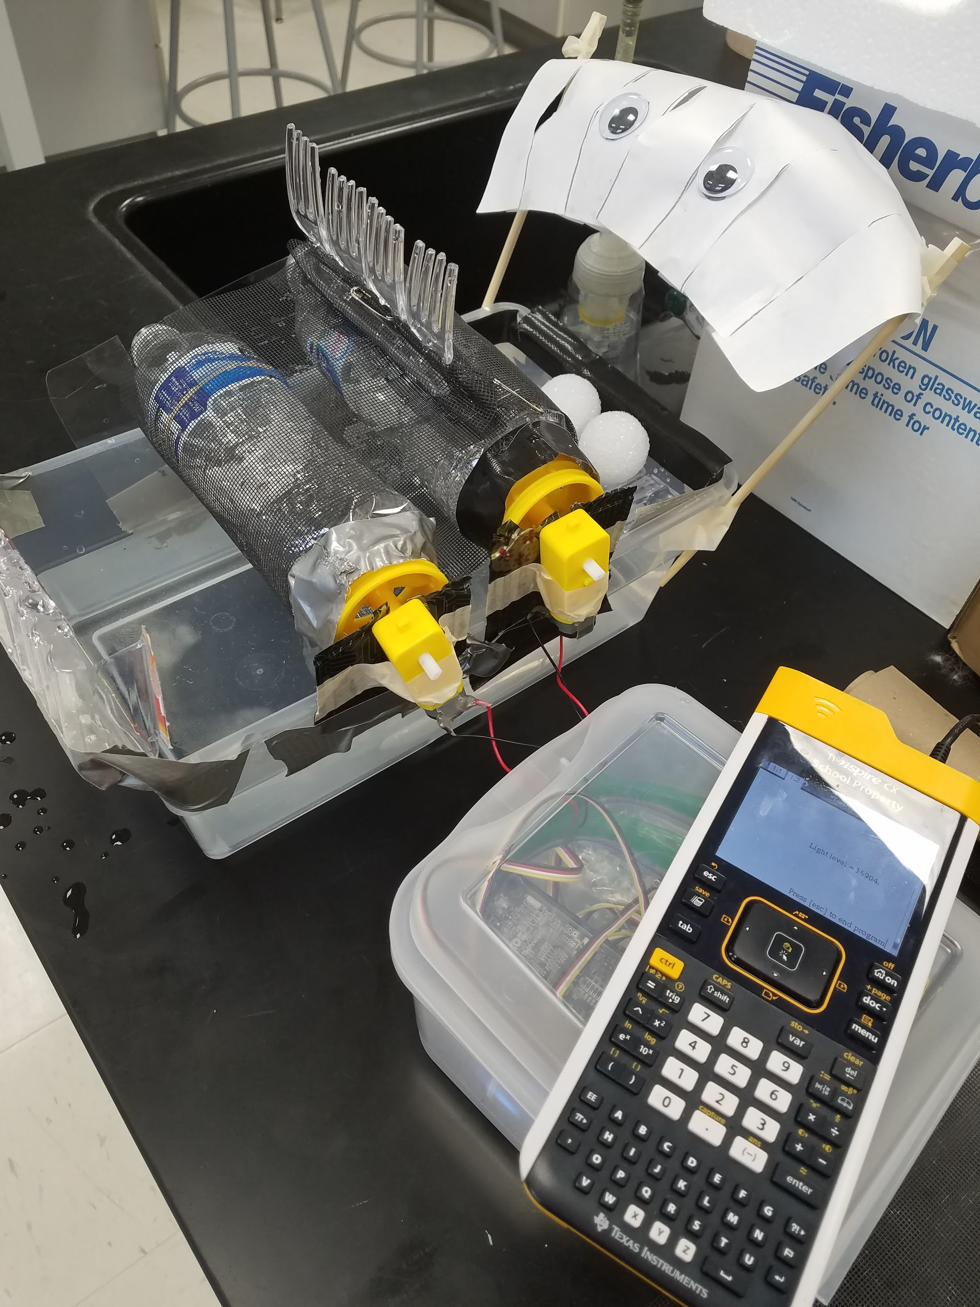
Student Work

Slide 12
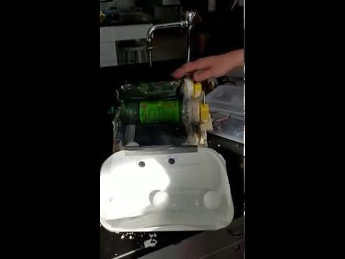
YES!

Slide 13
Brainstorm Ideas
Use the post-it notes provided to write ALL and ANY idea for the project.
There is no idea too OUTRAGEOUS!
ONE idea per Post-it
10 minutes INDIVIDUALLY
no talking or sharing yet

Slide 14
Questions to help with Brainstorming:
How will you move trash out of the water?
Where will the motors go?
How will you use the motors to move trash?
What materials could you use?
How will you protect any sensors from water?
Why are single-use plastics a problem?
What can be done to reduce the amount of trash in waterways?

Slide 15
Plan: Concept Sketching
Take a ½ sheet of Chart Paper and draw a Y shape
Sketch out the concepts for your Trash Wheel Design
No talking or collaborating yet
10 minutes to do 3 different sketches
Use a colored marker to critique your group member designs
Discuss and decide on one design that you should try to develop

Slide 16
Engineering Design & Coding Connection
Problem: How do we reduce the amount of trash that gets into our oceans?
Requirements:
Build a model of a trash interceptor that will remove waste from a waterway.
The model must be made of upcycled single-use plastics
The model must move a piece of trash (ping pong ball) from a water source to a seperate container outside of the water.
The model must include splash resistant protections for the sensors and electronics used.
Bonus: Create a way to automatically activate your trash interceptor when trash is present and turn off when trash is not present.

Slide 17
Documents and Info:
Access to Student Documents: http://bit.ly/SI19TW
Jessica Kohout
Email: jessica_kohout@hcpss.org
Twitter: @MrsKohout
Kevin Spry
Email: kspry@ti.com
Twitter: @kspry

