Slide 1
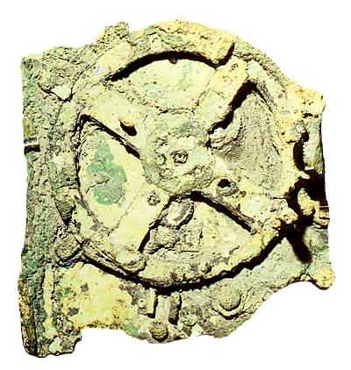
Notes:
Antikythera mechanism discovered in the sea off the island of Antikythera

Slide 2
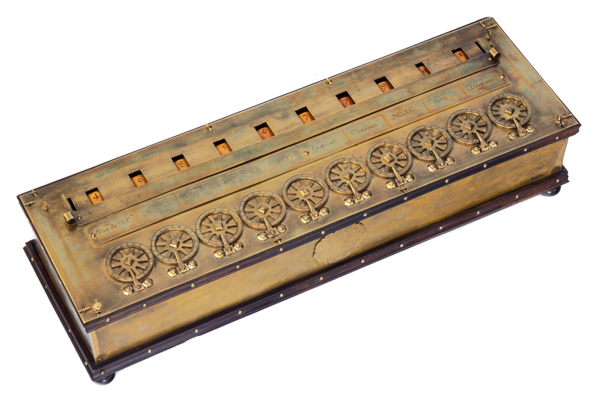
Notes:
Pascal’s calculating machine around 1600. Each dial turns the dial to the left one unit in a full rotation, an adding machine.

Slide 3
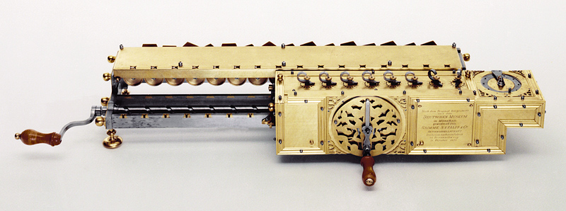
Notes:
Leibniz’s stepped reckoner. An early difference engine, could multiply and divide as well as add and subtract. About 1670.

Slide 4
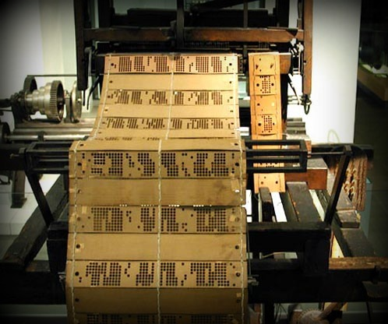
Notes:
The Jacquard loom invented about 1800 used punched cards and is the forerunner of punched computer cards and Hollerith code.

Slide 5
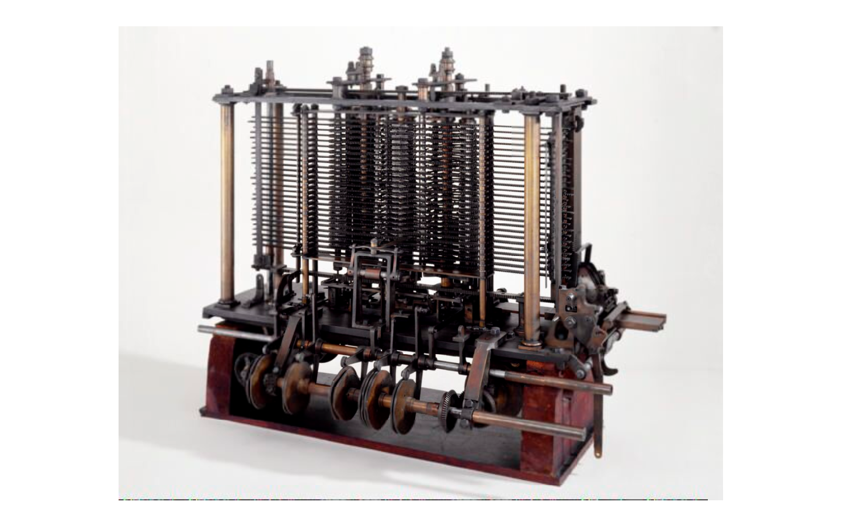
Notes:
Babbage’s difference engine designed around 1850 and built in 2002. The first automatic computing engine.

Slide 6
Notes:
The slide rule, beloved by many in their sixties. Developed by Oughtred 1630 following work by Napier on logarithms.

Slide 7
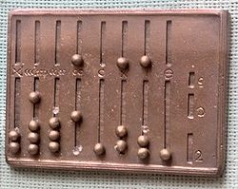
Notes:
Roman abacus.

Slide 8
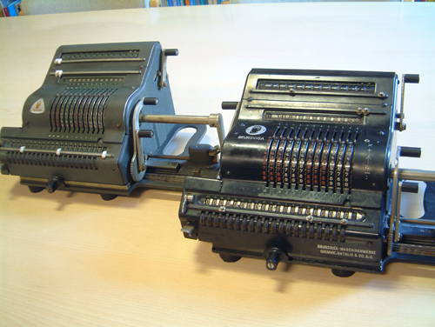
Notes:
Brunsviga calculating machines

Slide 9
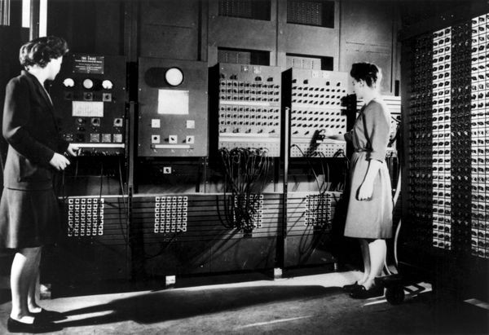
Notes:
The World’s first electronic all purpose computer, a truly digital machine. Built 1946 and acquired a 100 byte memory 7 years later. Used 20 000 valves and weighed 30 tons.

Slide 10
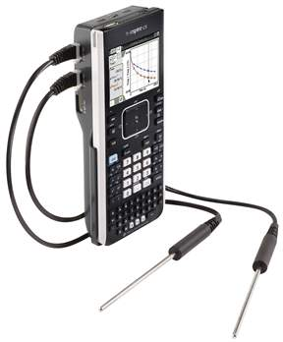
Notes:
The TI Nspire using Jack Kilby integrated circuits! Far more powerful than Eniac.

Slide 11
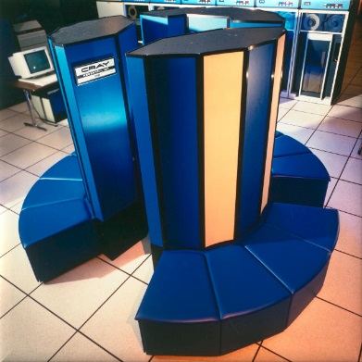
Notes:
A Cray supercomputer, but still not AI. This is the Cray 1, 64 bit words with a mega-word of RAM. Built in this shape to keep the wires as short as short as possible and so increase processing speed to 80 MHz. Still a long way off to-days laptops.

