Slide 1
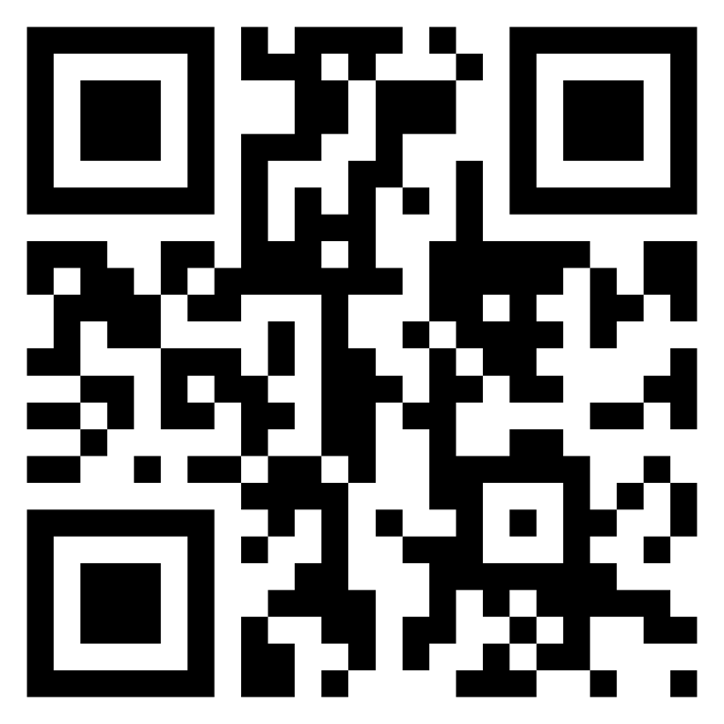
Meet TI-Rover Geometry Challenges Day TI-84 Plus CE TI-Basic
Texas Instruments
@ticalculators
www.TIstemProjects.com
Contact stem-team@ti.com with questions

Slide 2
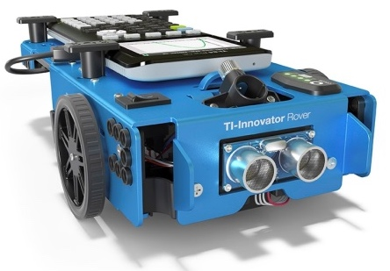
Meet the TI-Innovator™ Rover

Slide 3
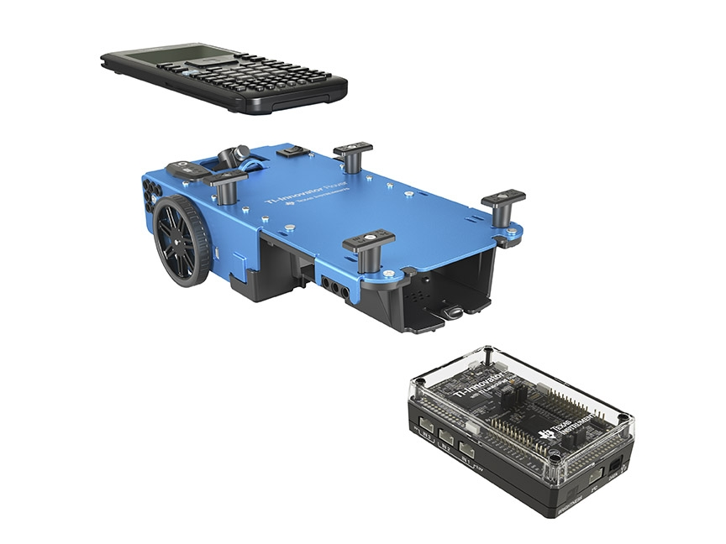
TI Graphing Calculator
TI-Innovator™ Rover
TI-Innovator™ Hub

Slide 4
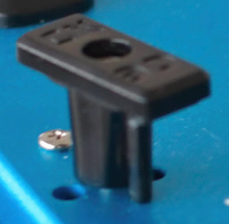
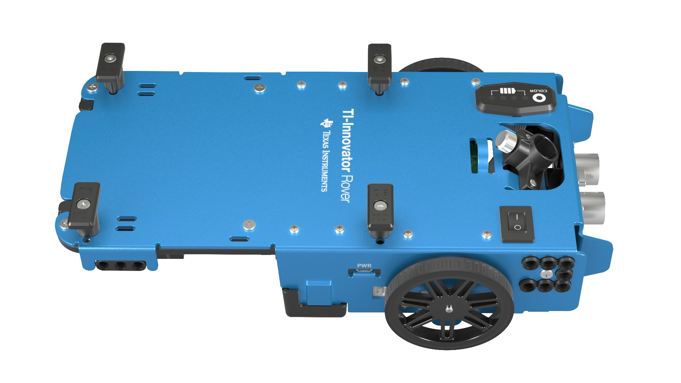
Rover from the top
Calculator holder posts.
Lift and twist to CE or CX side.
Red-Green-Blue (RGB) Color LED
Battery indicator
Marker holder
(Expo Fine and
Ultra Fine sizes)
Battery Charge with USB micro to wall adapter.
On/Off Switch

Slide 5
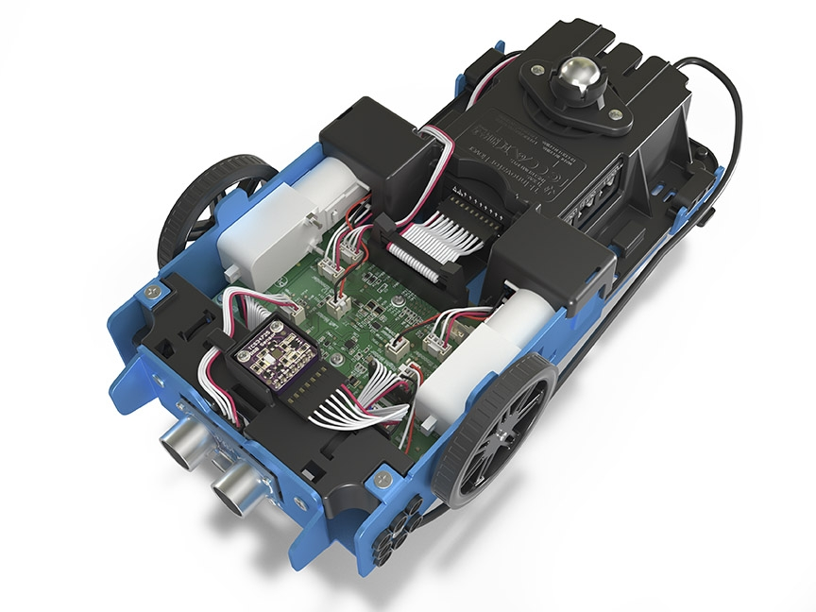
Turn Rover Over
What do you see?

Slide 6
Sensors on Rover
Motors to turn the wheels
Color sensor to detect different colors
Ranger to measure distance

Slide 7
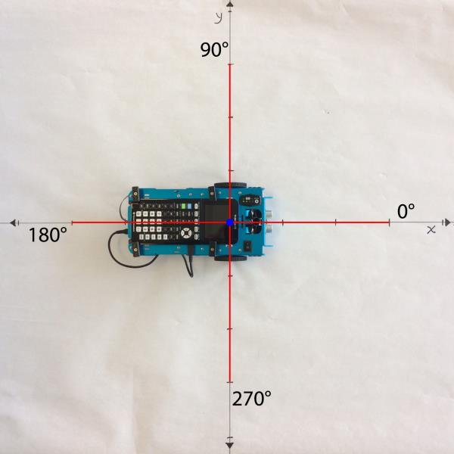
TI-Rover orientation and virtual grid
Rover programs set the initial position as the origin and the heading as 0 degrees measured from the x-axis.
Note: The Rover tracks its position on a virtual coordinate grid with a unit value of 10 cm. The coordinate grid position applies to the RV TO XY, RV TO POLAR, and RV TO ANGLE on the Drive RV Drive menu. The virtual grid also applies to the RV Path menu functions.

Slide 8
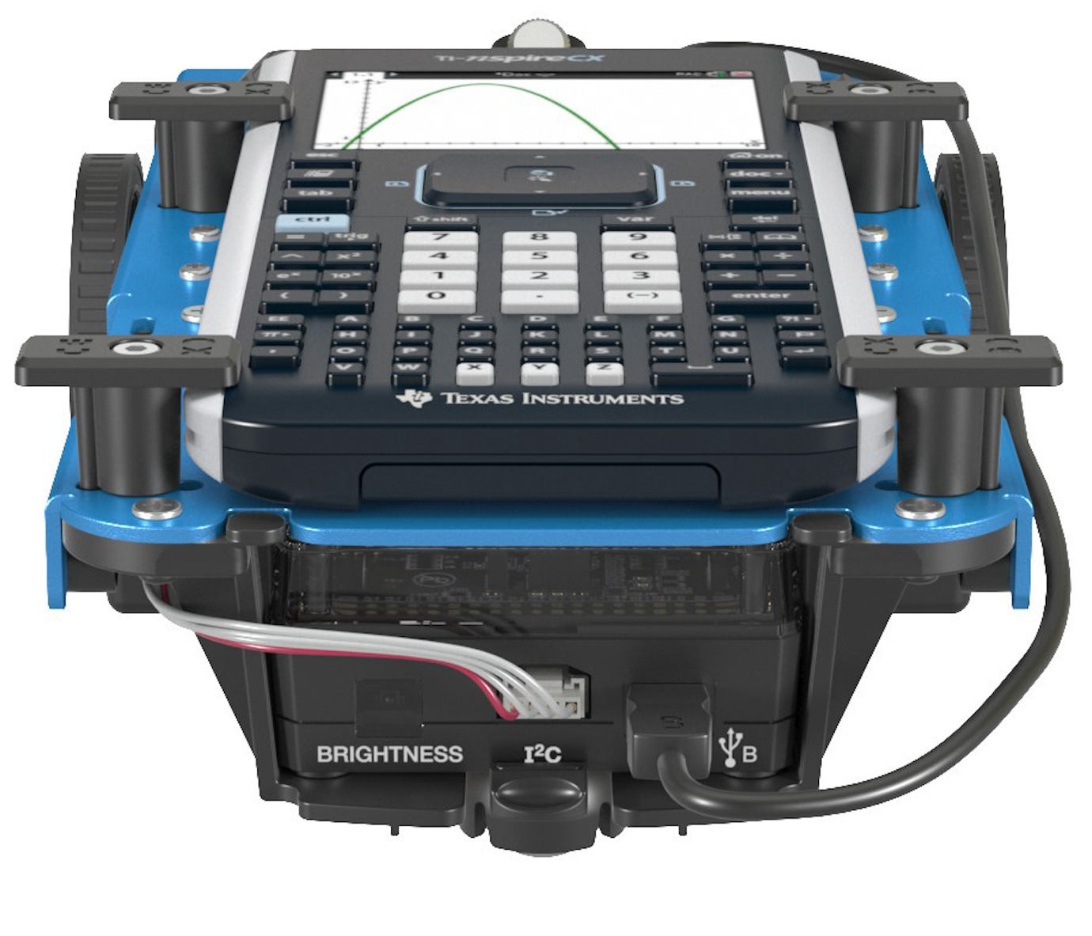
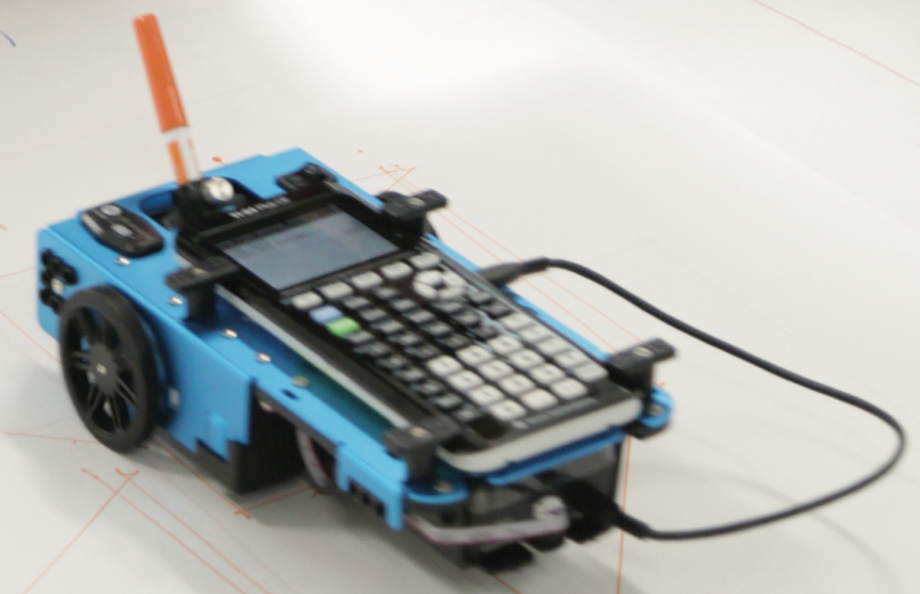
Connecting Rover to your calculator
1
Make sure that your Rover is switched on.
3
Plug A side into port on calculator the Rover Hub.
2
Plug B side into USB B port of the Rover Hub.
Unit-to-unit cable

Slide 9
Connecting your calculator to the Rover
Initial Connection
Step 1: Make sure that Rover is switched ON
Step 2: plug unit-to-unit cable into Hub
(Use end of cable labeled B)
Step 3: plug unit-to-unit cable into the calculator
(Use end of cable labeled A)
Troubleshooting
Try the following as a fast fix:
Step 1: unplug the unit-to-unit cable from the hub and the calculator.
Step 2: re-connect in the order of first Hub then calculator second.
If the fast fix does not work, try these steps:
Step 1: unplug unit-to-unit cable from both the hub and the calculator
Step 2: Switch Rover OFF
Wait a second
Step 3: Switch Rover ON
Step 4: plug unit-to-unit cable into Hub
Step 5: plug unit-to-unit cable into the calculator

Slide 10
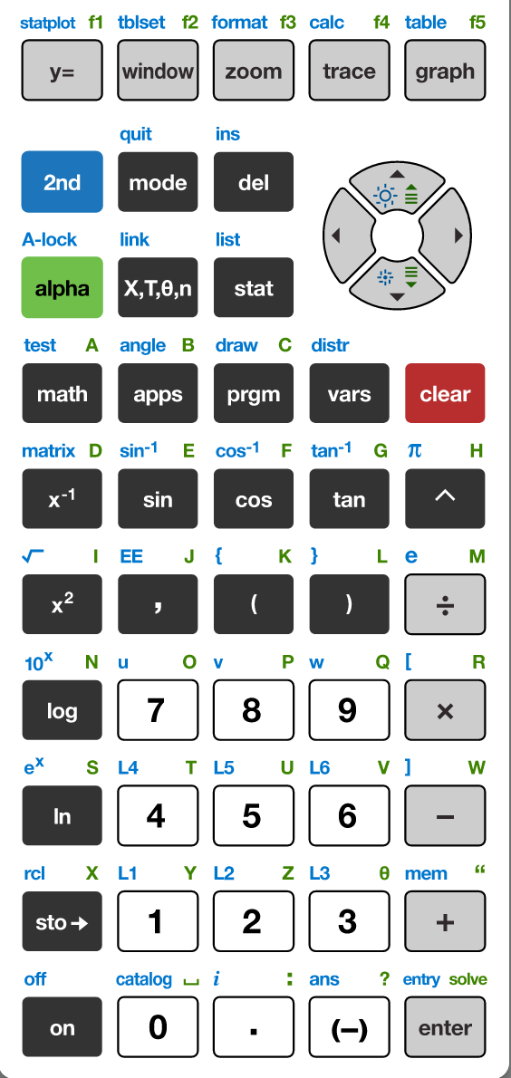
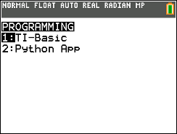
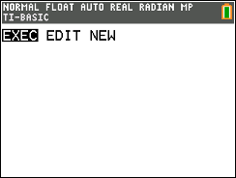
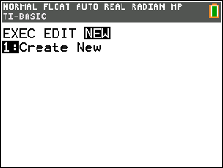
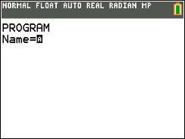
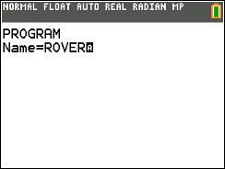
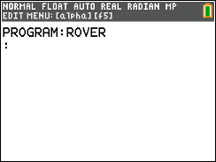
Creating a new Rover Program
1
2
3
4
Press [enter] or
Press [1] to
select 1: TI-Basic
You have the option to execute (run),
edit or create programs.
Use right arrow key to move to NEW 1:Create New
Press [1] or [enter] to select.
5
5
6
You are prompted to enter a program name.
The blinking A cursor shows that you are in alpha entry mode. The
green alpha labels on the keys are active.
Type your program name and press [enter].
You are now in position to begin entering commands to your program.
Press the [prgm] key to create, edit and execute
TI-Basic programs.

Slide 11
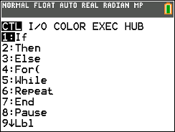
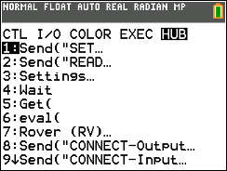
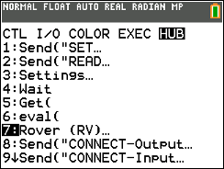
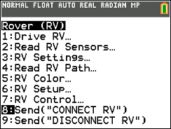
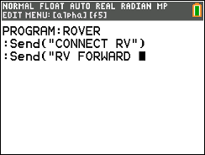
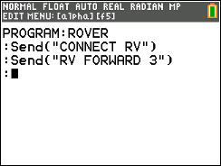
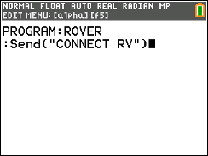
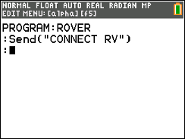
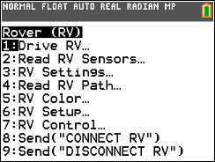
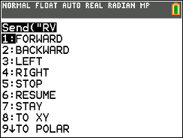
Entering a Rover Program
1
2
3
4
Press the [prgm] key again to bring up the program edit menu. You will see this menu when you are editing a program.
Press right arrow repeatedly or
left arrow to move to the HUB
menu.
Use down arrow to move to 7: Rover and press [enter]
or press [7]
Use down arrow to move to 8: Send(“Connect RV”) and press [enter] or press [8]
7
8
5
6
The command is pasted to your program.
Finish the command by entering
the number of units to drive, then close the command with
Alpha “ (plus key) and close paren ) followed by
[enter] to move to the next line.
The command is pasted to your program.
Send(“Connect RV”) is required at the beginning of every Rover program.
Press [enter] to move to a new line in the program. Every command must be on its own line.
Press [prgm], left arrow to HUB menu, [7] Rover, [1] Drive
then [enter] to select FORWARD

Slide 12
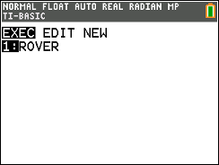
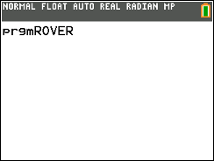
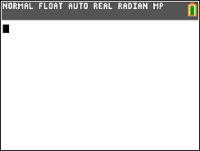
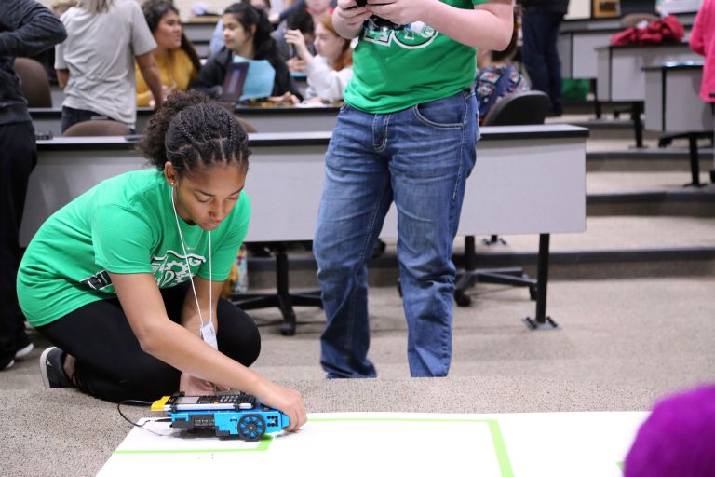
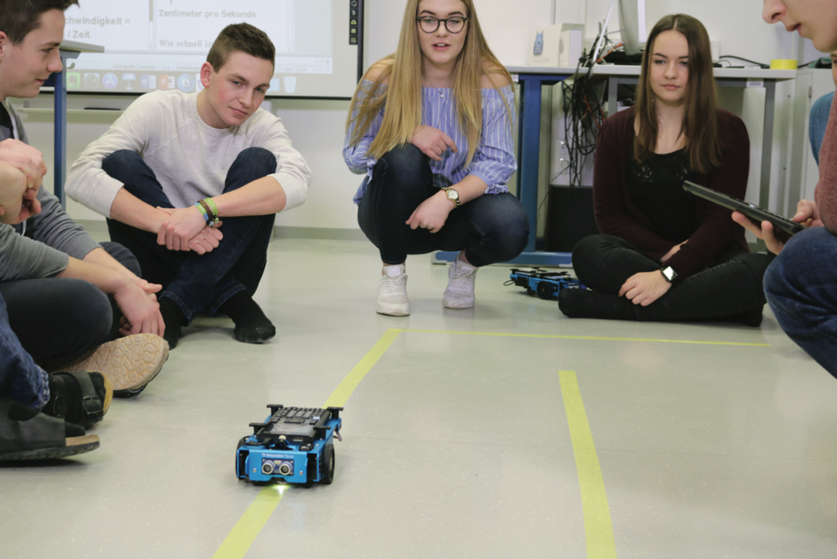
Running (Executing) a Rover Program
1
2
3
4
Press [2nd] [quit] (mode key) to. exit the program editor and return to home screen.
You run programs on the home screen. Press [prgm] again to see the menu of programs to run.
Select the program to run from the EXEC (execute) menu. In this case press [enter] or [1].
Your selection is pasted to the home screen.
Make sure that your Rover is connected and switched on.
Press [enter] to run the program.
Your Rover will drive forward 3 units.

Slide 13
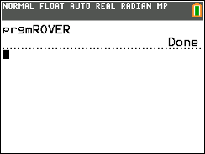
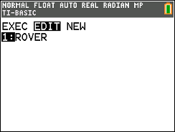
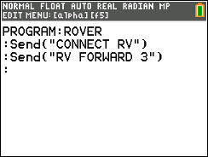
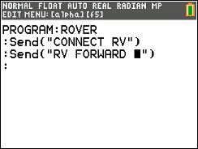
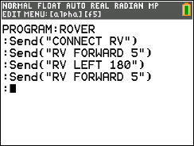
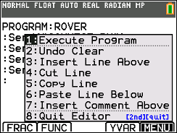
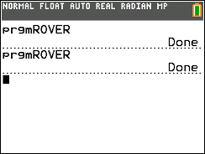
Editing a Rover Program
1
2
3
4
Press the [prgm] key again to bring up the program menu.
Press right arrow to see a menu of programs to edit. Select a program from the menu.
Use arrow keys to move the cursor to a value to change.
Type over the original value with a new value, then use the cursor to move to the next line.
5
6
7
8
Add a turn command and another FORWARD command from the Rover Drive RV… menu.
You have the option to run the program from a menu within the program editor.
Press [alpha] f5 (graph key).
Make sure that your Rover is connected and on a surface ready to roll. tPress [1] or [enter] to run (execute) the program.
The calculator program is done. You are ready for your next task.

Slide 14
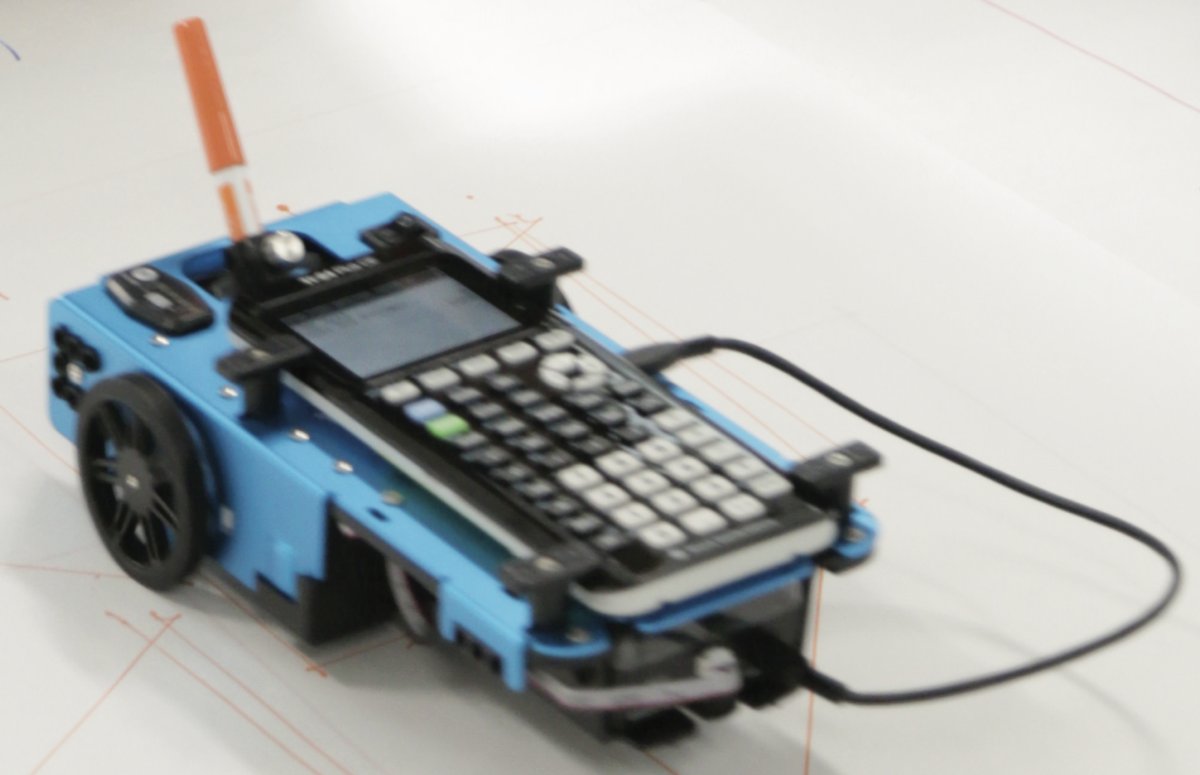
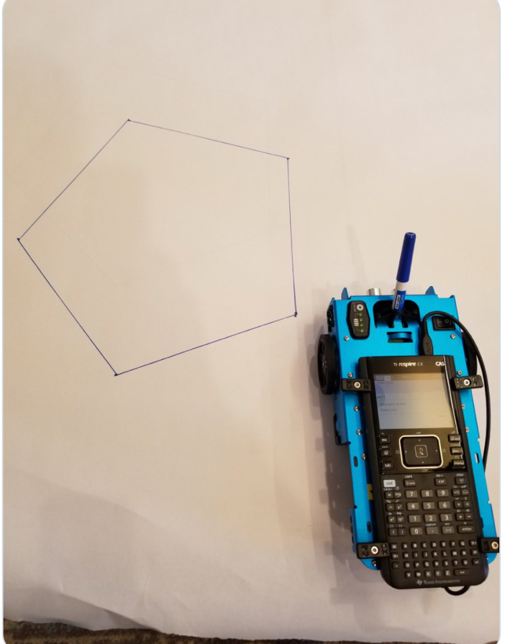
Drawing with the TI-Rover
Use Expo Fine or Extra Fine dry erase markers.
The markers drop into a slot on the front of the Rover.
Note: The Texas Instruments Workshop Loan Rover cases include markers.
Drawing surface: We recommend butcher paper held in place with painters tape on a hard surface.

Slide 15
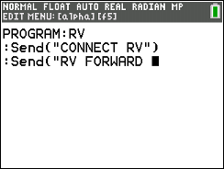
MAKE IT MOVE!
New Program:
Task: Discover how far Rover drives per unit.
Use differing values (1-20) to determine what 1 Rover unit is.
Enter a value for the number of grid units to drive forward.
Finish the command by entering
the number of units to drive,
then close the command with
alpha quotes (plus key) and and close paren ) followed by
[enter] to move to the next line.
Notes:
Give students time to explore with different distances to figure out.

Slide 16
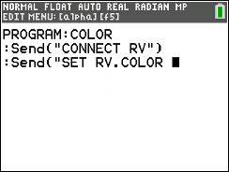
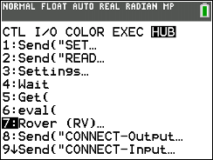
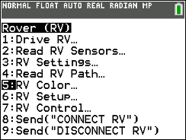
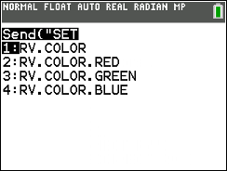
Change the Color
New Program:
Task: Set the color output of the RGB LED.
Each color takes a value (0-255).
Challenge Task: Try to make Yellow
Find the RV.COLOR command on the Rover menu.
Enter values for RED, GREEN and BLUE separated by spaces, [alpha] space (0 key).
Then close the command with alpha quotes (plus key) and and close paren ) followed by [enter] to move to the next line.

Slide 17
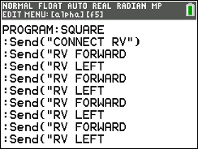
Explore angles
New Program:
Task: Drive a square.
Challenge Task: Try to drive an equilateral triangle.
Enter values for forward drive distance and turn angle.
Close the commands with alpha quote (plus key) and
close paren ) followed by [enter] to move to the next line.
The program above is a framework for driving a square.
Enter values for distance and turn angle.

Slide 18
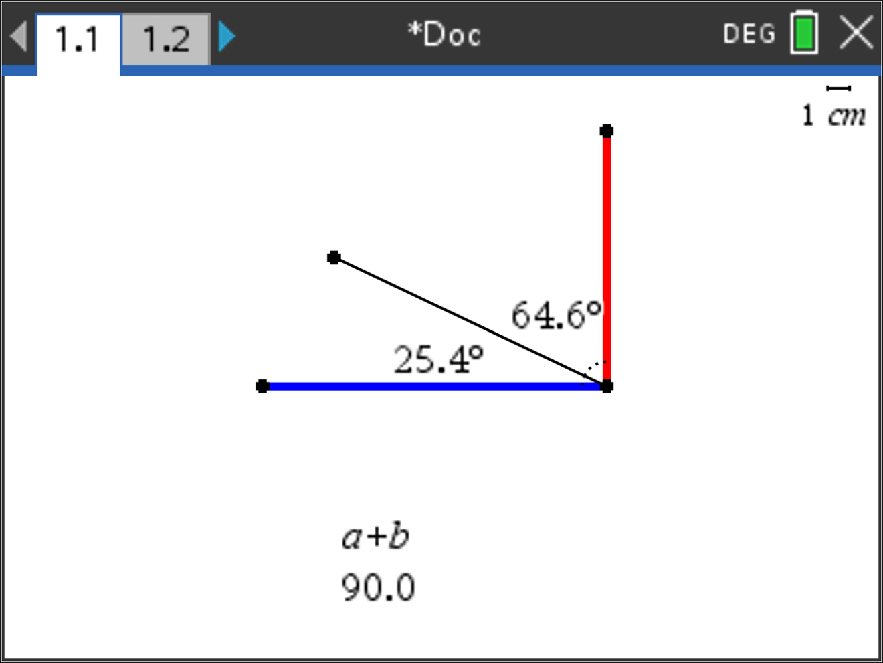
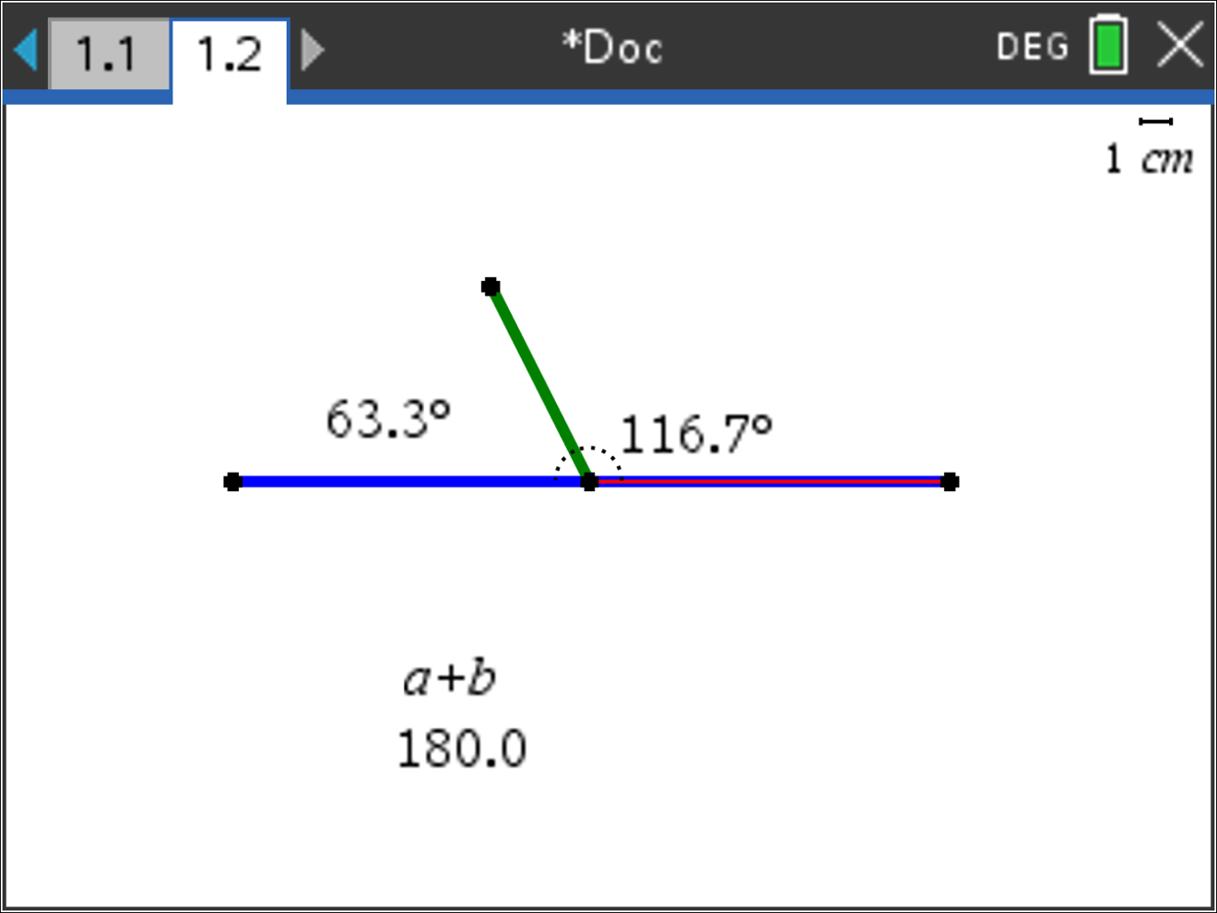
Quick Math Reminders
Complementary Angles:
Sum to 90 degrees
Supplementary Angles:
Sum to 180 degrees

Slide 19
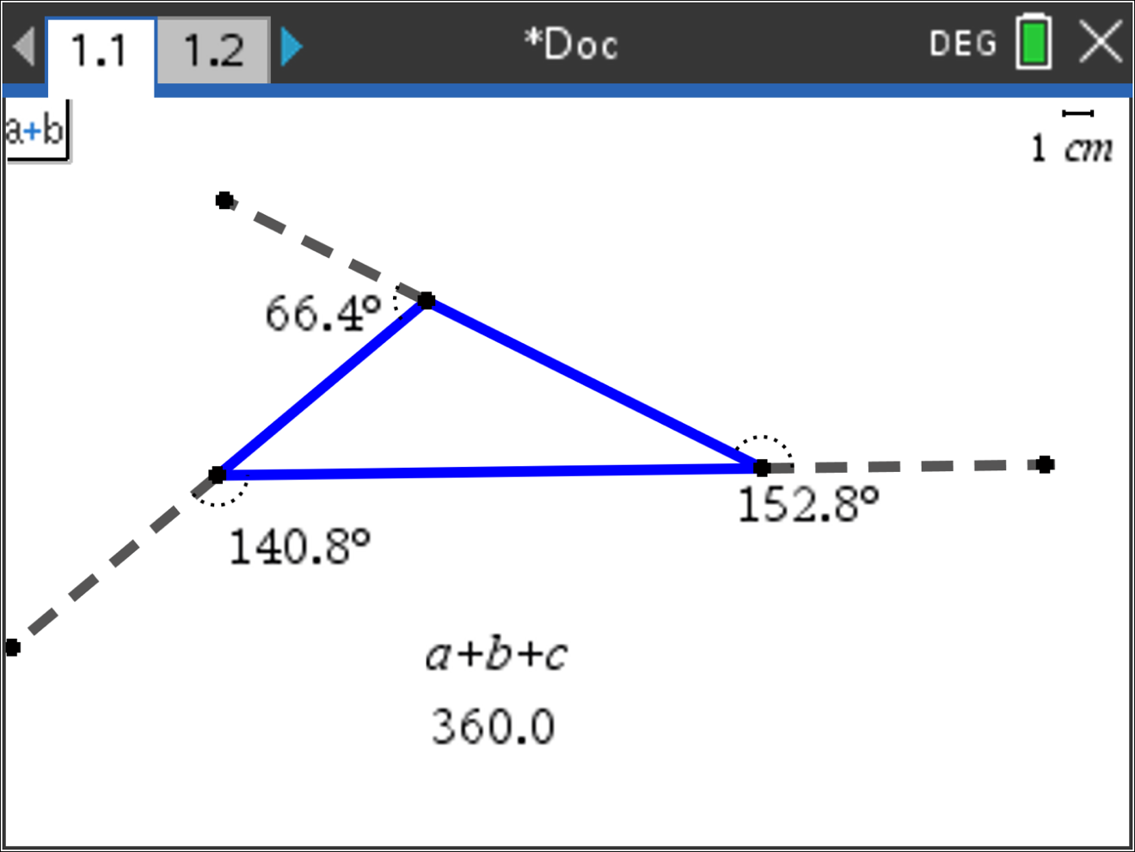
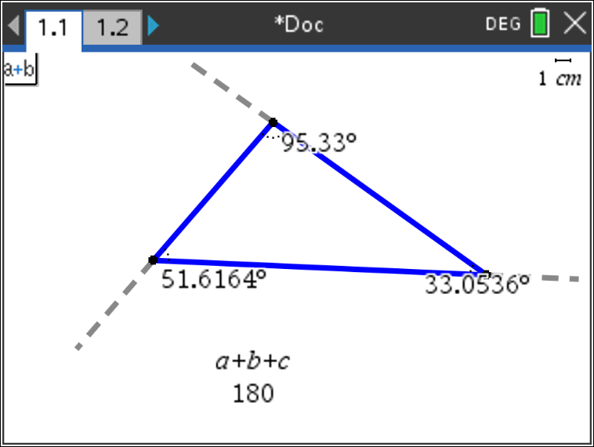
Quick Math Reminders
Exterior angles:
Interior Angles:

Slide 20
Logic Challenge
Task: Drive the figure shown without crossing any lines or going back over a line and without picking up the pen.
When you are ready put the pen in and trace your path
Notes:
First challenge is to drive the shape without crossing any lines and without picking up the pen.

Slide 21
Where can you go next with TI-Rover?
Drive an obstacle course
Drive a design
Draw artwork
Use a For loop
to draw polygons
Write your name
Navigate a map
Park your Rover

Slide 22
Quick Math Reminders
Pythagorean Theorem

Slide 23
Logic Challenge 2
Task: Drive the figure shown without crossing any lines or going back over a line and without picking up the pen.
When you are ready put the pen in and trace your path
Notes:
First challenge is to drive the shape without crossing any lines and without picking up the pen.
Second will be to drive at least one segment in reverse direction.

Slide 24
Logic Challenge 2
3
2
4
5
6
1
7
9
8
10
Notes:
First challenge is to drive the shape without crossing any lines and without picking up the pen.
Second will be to drive at least one segment in reverse direction.

Slide 25
Thank you!
See www.TIstemProjects.com for more TI STEM and coding activities and projects.

