Slide 1
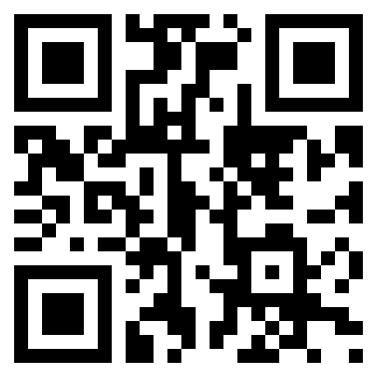
Meet the TI-Innovator Hub TI-84 Plus CE TI-Basic
Texas Instruments
@ticalculators
www.TIstemProjects.com
Contact stem-team@ti.com with questions

Slide 2
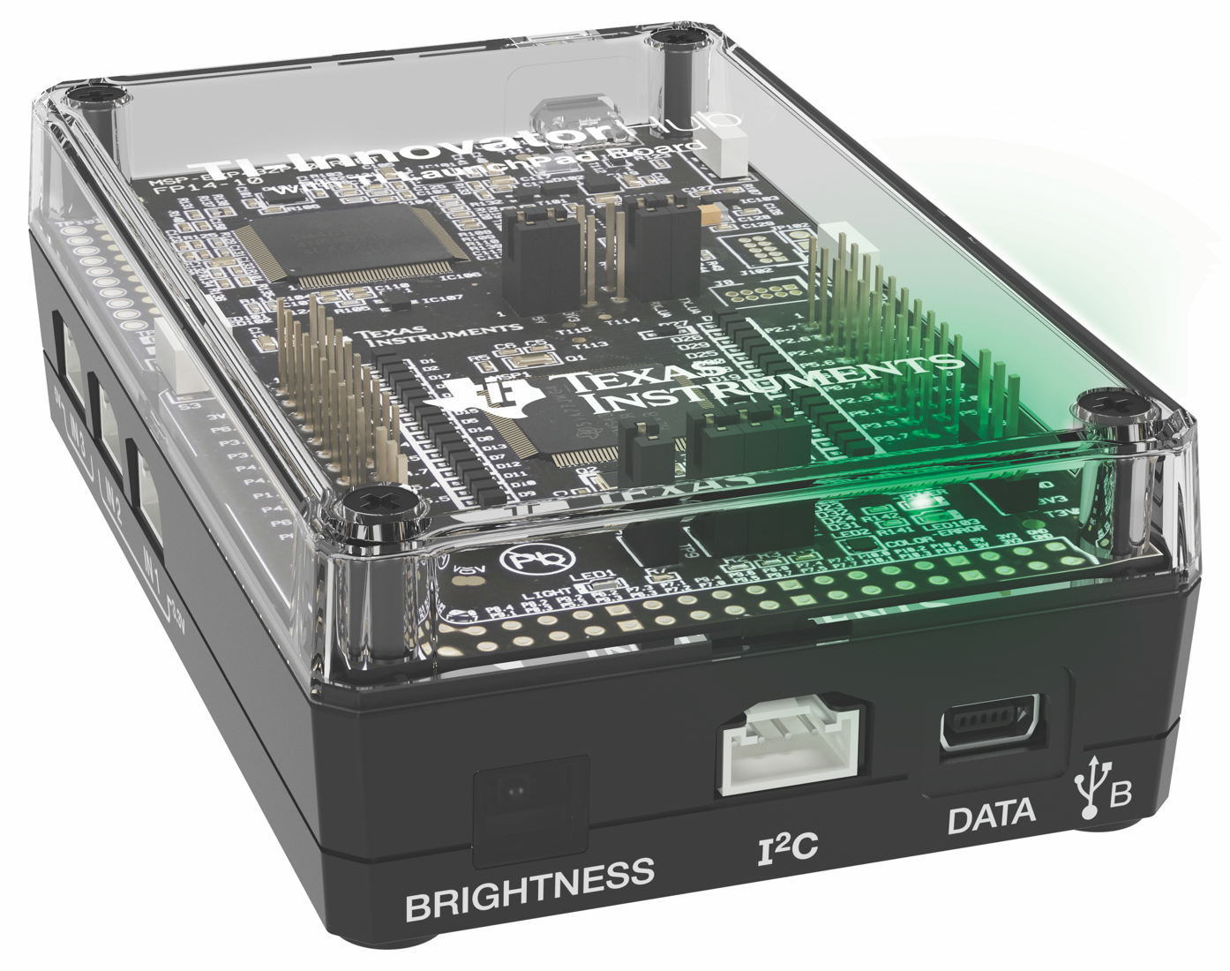
Meet the TI-Innovator Hub

Slide 3
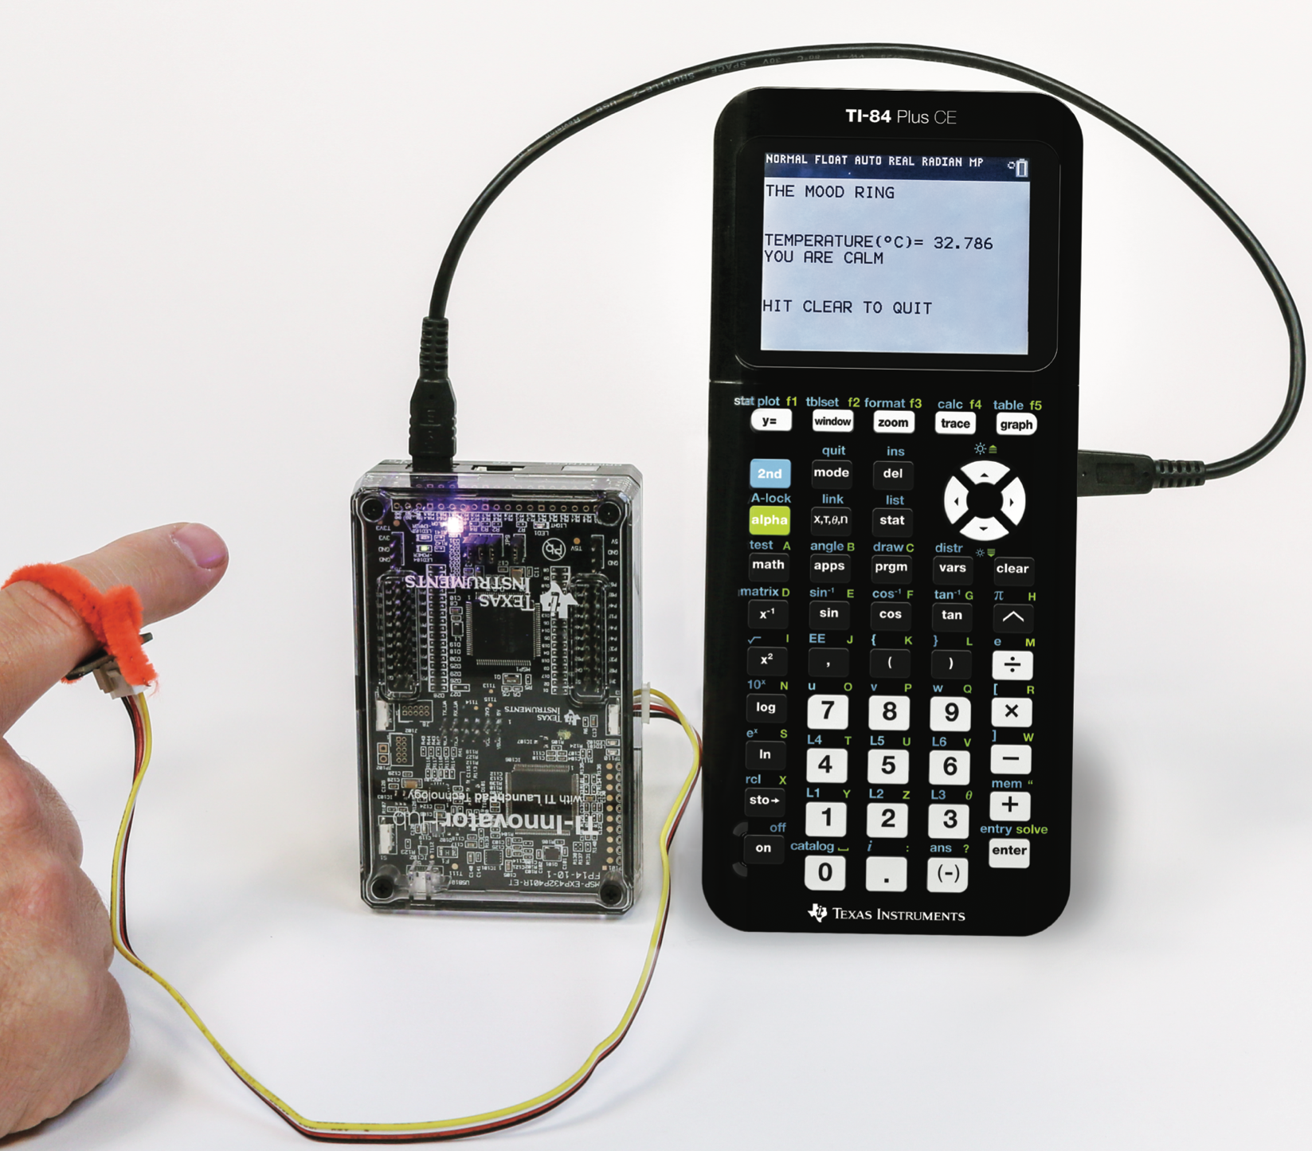
Built-in RGB LED Output
TI-Innovator™ Hub
TI Graphing Calculator
External Sensor Input

Slide 4
Hub from the Front
Red-Green-Blue (RGB) Color LED
(Built-in)
USB Port (mini) to connect to calculator and computer
Brightness Sensor (Built-in)
I2C Port used to
connect to Rover

Slide 5
Hub from the Bottom
Speaker
(Built-in)

Slide 6
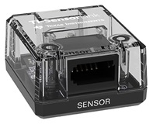
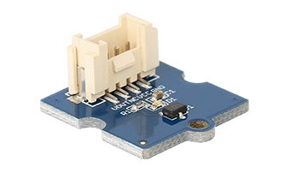
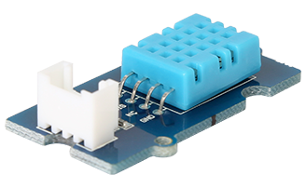
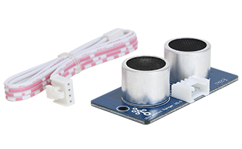
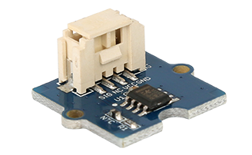
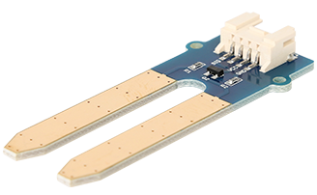
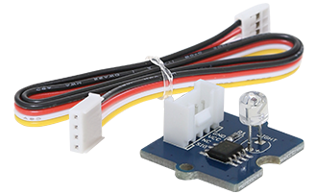
Hub from the side – input ports
Input ports for external sensors with Grove connectors
3.3 Volt ports, IN 1 and IN 2, required for Ranger and DHT
Vernier SensorLink
Adaptor
Magnetic Field (Hall Effect)
Digital Temperature
and Humidity (DHT)
Ranger
Temperature
Moisture
Light Level

Slide 7
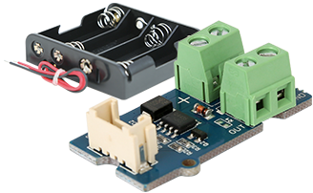
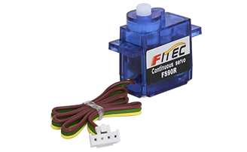
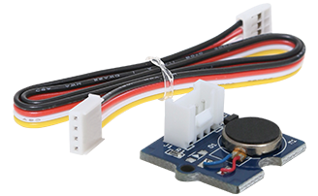
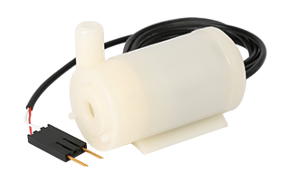
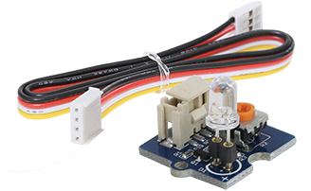
Hub from the side – Output ports
Output ports for external motors and other outputs with Grove connectors
5 Volt port, OUT 3,
required for motors
MOSFET controls power level to pump and other devices
Vibration Motor
External LED
Continuous Servo Motor
Pump

Slide 8
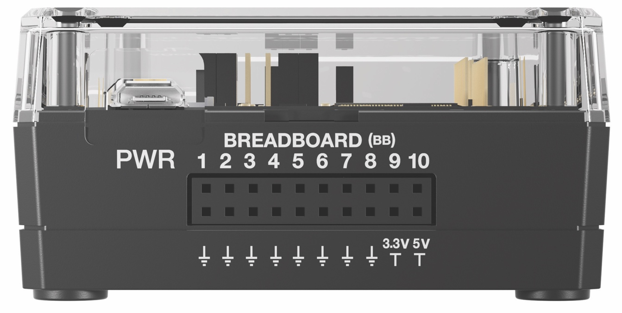
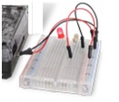
Hub from the Back – breadboard ports
USB Port (micro) connects to external batteries and wall socket.
Connects to computer for updating Hub firmware.
Breadboard ports
Path to STEM Projects with breadboard
RGB Array

Slide 9
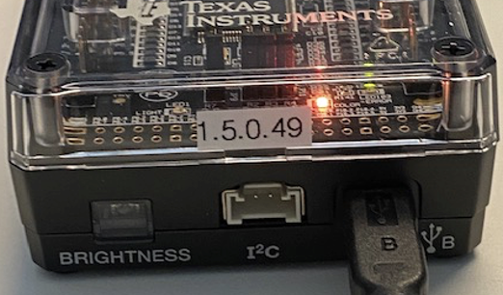
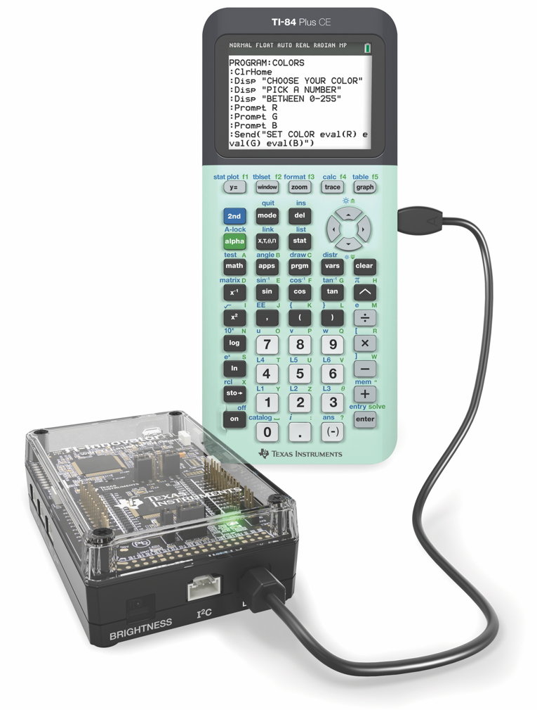
Connecting the Hub to your calculator
Note: The Hub is powered by the calculator. When the cables are connected the Hub goes through a brief “boot-up” process. During the boot-up the RGB LED displays a color that indicates the Hub firmware release, in this case, orange.
2
1
Plug A side of cable into port on calculator.
Plug B side of cable into USB B port of the Hub.
Unit-to-unit cable

Slide 10
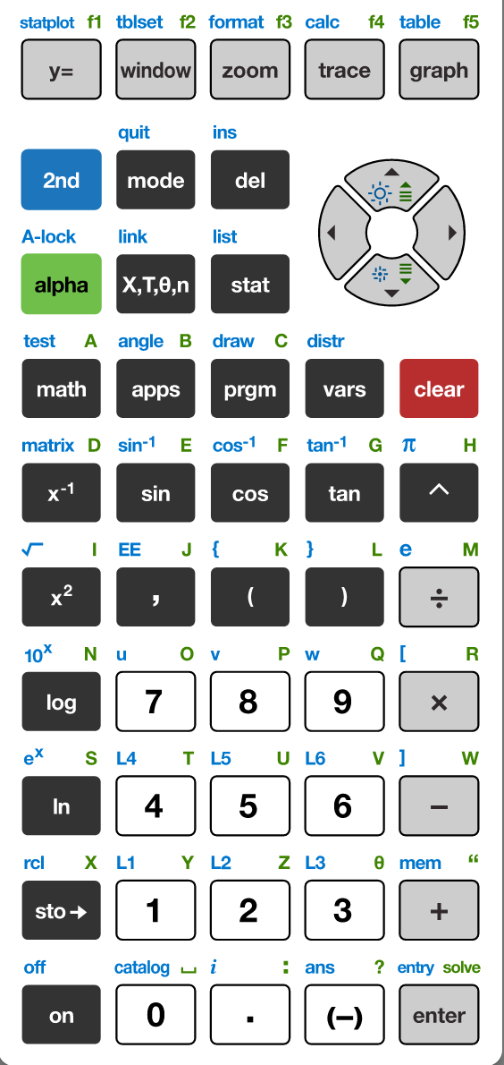
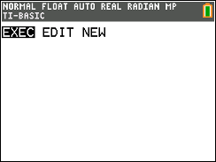
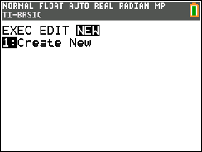
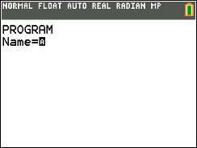
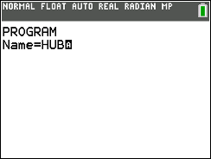
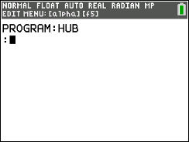
Creating a new Hub Program
1
2
3
You have the option to execute (run),
edit or create programs.
Use right arrow key to move to NEW 1:Create New
Press [1] or [enter] to select.
5
5
6
You are prompted to enter a program name.
The blinking A cursor shows that you are in alpha entry mode. The
green alpha labels on the keys are active.
Type your program name and press [enter].
You are now in position to begin entering commands to your program.
Press the [prgm] key to create, edit and execute
TI-Basic programs.

Slide 11
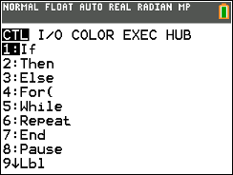
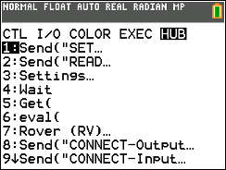
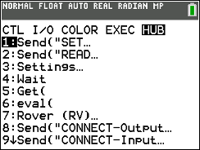
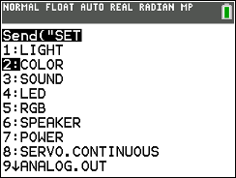
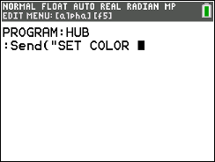
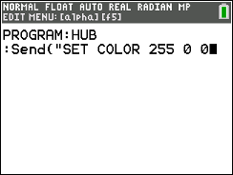
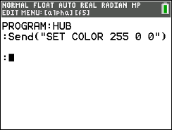
Entering a Hub Program
1
2
3
4
Press the [prgm] key again to bring up the program edit menu. You will see this menu when you are editing a program.
Press right arrow repeatedly or
left arrow to move to the HUB
menu.
Press [enter]
or press [1] to select the 1:Send (“Set… menu.
Use down arrow to move to 2: COLOR and press [enter] or press [2] to select 2:COLOR.
5
6
7
The command is pasted to your program.
Send(“SET COLOR is the command that controls the Red-Green-Blue (RGB) LED of the Hub.
Enter values for Red, Green and Blue by typing 255 for Red, [alpha] [0] for a space to separate red from green, 0 for Green, [alpha] [0] for a space and 0 for Blue.
Note: 255 is the maximum value (full power) and 0 is off.
Close the quotes and parentheses by pressing [alpha][+] for a quote and [)].
Press [Enter] to move to the next line of the program.
Note: Each program statement must start on a new line.

Slide 12
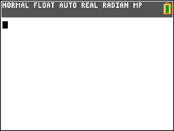
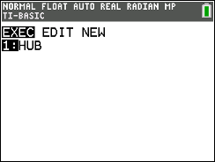
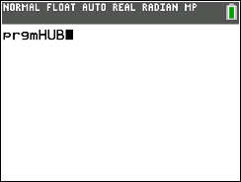
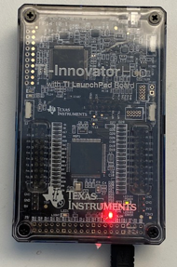
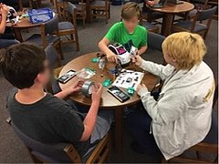
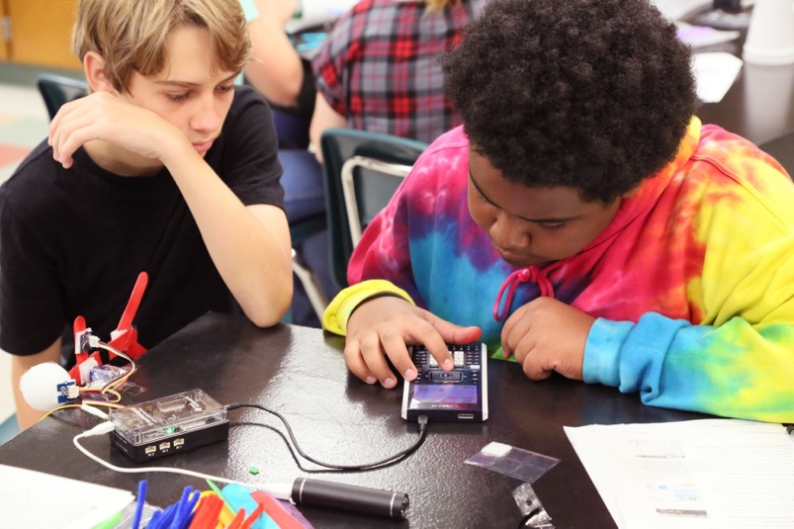
Running (Executing) a Hub Program
1
2
3
4
You run programs on the home screen.
Press [2nd] [quit] (mode key) to. exit the program editor and return to home screen.
Press [prgm] to see a menu of programs to run.
Select the program to run from the EXEC (execute) menu. In this case, press [enter] or [1].
Your selection is pasted to the home screen.
Make sure that your Hub is connected to the handheld.
Press [enter] to run the program.
The Red-Green-Blue (RGB) LED will turn Red.

Slide 13
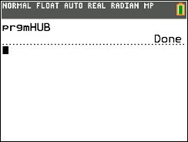
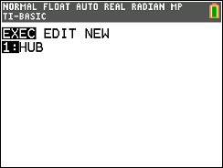
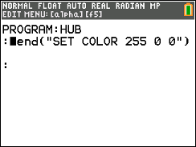
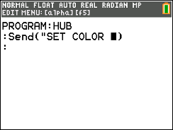
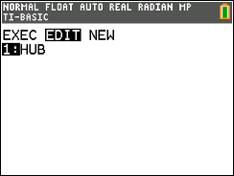
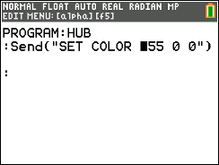
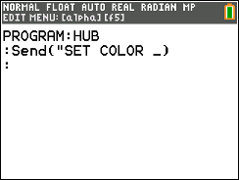
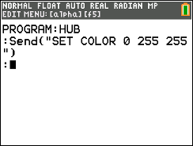
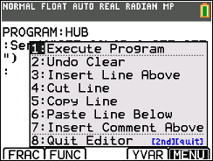
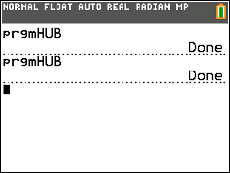
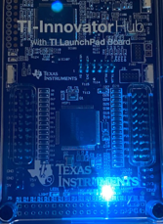
Editing a Hub Program
1
2
3
4
Press the [prgm] key again to bring up the program menu.
Press right arrow to see a menu of programs to edit. Select a program from the menu.
Use arrow keys to move the cursor to a value to change.
Use [del] to delete the red, green and blue values.
5
6
7
8
Press [2nd] [del] to start insert entry mode. Note the underline insert cursor. Type [0] for the red value, [alpha] [0] space, [2][5][5] for the green value, [alpha][0] space, then [2][5][5] for the blue value.
You have the option to run the program from a menu within the program editor.
Press [alpha] f5 (graph key).
Make sure that your Hub is connected. Press [1] or [enter] to run (execute) the program.
The calculator program is done. You are ready for your next task.

Slide 14
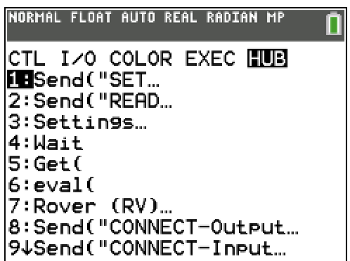
TI-Innovator Hub Menus
Hub Menu
Send(“SET…
Outputs
Send(“Read…
Inputs
Settings
Send(“Connect
Outputs
Send(“Connect
Inputs

Slide 15
Copying and Pasting a Line of Code
1
2
3
4
Use arrow keys to move the cursor to a position anywhere on the line that you would like to copy.
Press [alpha][graph] (f5) then select 5:Copy Line from the menu.
After you select you will be returned to the editor.
Use arrow keys to move the cursor to any location on the line above where you would like to insert the copied line.
Press [alpha][graph] (f5) then select 6:Paste Line Below from the menu. The copied line will be pasted.
5
You can paste the copied line again by returning to the [alpha][graph] (f5) edit tools menu and then select 7:Paste Line Below.

Slide 16
Editing an existing Program File
1
2
3
4
5
Right Arrow to the EDIT menu.
To edit an existing program, use the Up and Down Arrow keys to select a program.
Press [enter] to open a program in the editor..
You can now make changes to the program or run the program.
6
Press the [prgm] key to create, edit and execute
TI-Python programs.
Use the [alpha][graph] (f5) for the program edit tools menu.

Slide 17
Copying/Replicating a TI-Basic Program File
1
2
3
4
Press [prgm] then select Create New program. Enter a name for the program.
You are now in the program editor..
Press [2nd][sto] (rcl) to paste the contents of another program into the current program.
Press [prgm] then right arrow to the EXEC menu. Select the program that you would like to copy. In this example, we will copy 1:BLINK.
5
6
You now see the program that you will copy listed on the screen. Press [enter] to complete the copy process.
The new program is now ready to edit.

Slide 18
Entry and Edit Tips
Use number key shortcuts or arrow keys and [enter] to select from menus
Use arrow keys to move the cursor around the screen.
Use [alpha] repeatedly to cycle from numeric, to lower case alpha to upper case alpha entry mode. The cursor indicates the current mode.
Use [2nd] [A-lock] to lock to alpha entry or to return to numeric entry.
Use [prgm] to select programs to run, edit or to create a new program.
Use [prgm] when editing a program to bring up the programming menus, including the Hub menu.
Use [alpha][graph] (f5) for the program edit tools menu (copy line, paste line, insert line, undo clear, etc.)
Use [del] to delete the character at the current cursor location.
Use [2nd][del] (ins) to insert at the current location.
Use [clear] to clear a line or to back out of a menu.
Use arrow keys to move to the end of a line and then press [enter[ to complete a statement and move to the next line.
Use [2nd] [quit] to leave the program editor and return to the calculator home screen.

Slide 19
Color Outputs

Slide 20
Set the color
Task: Set the color output of the
Red, Green, Blue (RGB) LED.
Each color takes a value
of (0-255).
Challenge Tasks:
Try to make Yellow
Try to make Cyan
Try to make Magenta
Press [prgrm] then right arrow to NEW. Select 1:Create New.
Enter the program name by pressing the keys associated with the green letter labels.
Paste the Set Color command by pressing [prgm] then right arrow or left arrow to the Hub menu. Select 1:Send(“SET…) then select 2:COLOR
New Program:
Enter values for Red, Green and Blue separated by spaces ([alpha] [0]).
Close the quotes ([2nd][+]) and parentheses. Press [enter] to complete the statement.
Run your program by selecting the program edit menu [alpha][graph] f5. Then select 1:Execute Program.

Slide 21
Create and Name a Color
Task: Create your own color and give it a name.
Challenge Tasks:
Print the name of your color.
Press [prgm] then right arrow to edit then select your program to edit from the menu.
The Disp command is available from the [prgm] I/O menu.
Put your message in quotes using [alpha][+].
Enter alpha characters by pressing [alpha] then the letter key associated with the green labels.”
Add to previous Program:

Slide 22
Display a series of colors
Task: Display a sequence of colors for 2 seconds each.
Challenge Tasks:
Try to have your LED match the pattern of a traffic light.
Try to have your LED turn off at the end of the sequence.
To remove the Disp statement, move your cursor to the row with Disp and press [clear].
The Wait command pauses the program for the number of seconds that you enter as an input. Wait is available at 4:Wait on the program Hub menu.
Press [prgm] Left Arrow to the HUB menu, select 4:Wait
Enter a value for the number of seconds to pause the program. You can use decimal values.
Edit previous Program:

Slide 23
Turn the LED ON and OFF
Extra
Task: Set the RGB LED to a color then keep ON for 2 seconds then turn the LED OFF for 2 seconds.
Challenge Tasks:
Try to blink (turn on and turn off) 4 times
Try to blink 4 times in 8 seconds
The Wait command pauses the program for the number of seconds that you enter as an input.
What values for the red, green and blue inputs to the color.rgb() function will turn the LED off?
Press [prgm] Left Arrow to the HUB menu, select 4:Wait
Enter a value for the number of seconds to pause the program. You can use decimal values.
New Program:
You can copy and paste a line. Press [alpha][graph](f5) to see the edit tools menu. Use 5:Copy Line to copy the current line. Use 6:Paste Line Below to paste the copied line.

Slide 24
Blink the LED Repeatedly
Extra
Task: Set the RGB LED to a color then keep ON for 2 seconds then turn the LED OFF for 2 seconds.
Challenge Tasks:
Try to blink (turn on and turn off) 4 times
Try to blink 4 times in 8 seconds
For(N,1,10) closed by an End command sets up a loop that will repeat the statements in a block of code.
Note: N is the loop counter variable. 1 is the first value for N and 10 is the last value for N.
Press [prgm], then select For( from the CTL (Control) menu.
To complete the block of code to repeat select End from the CTL menu.
New Program:

Slide 25
Sound Outputs

Slide 26
Play a Sound Tone
Task: Play a sound tone by entering a value for frequency (sound vibrations per second) and a value for time in seconds to play the tone.
Note: Human voices tend to be in the 85 to 255 Hertz (vibrations per second) range.
What is the lowest tone that you can hear?
What is the highest tone that you
can hear?
Press [prgrm] then right arrow to NEW. Select 1:Create New.
Enter the program name by pressing the keys associated with the green letter labels.
Paste the Set Sound command by pressing [prgm] then right arrow or left arrow to the Hub menu. Select 1:Send(“SET…) then select 3:SOUND
New Program:
Enter values for the sound frequency and the time to play the sound separated by a space ([alpha] [0]).
Close the quotes ([2nd][+]) and parentheses. Press [enter] to complete the statement.
Run your program by selecting the program edit menu [alpha][graph] f5. Then select 1:Execute Program

Slide 27
Find your favorite sound tone, and give it a name.
Task: Play a sound tone by entering a value for frequency (sound vibrations per second) and a value for time in seconds to play the tone.
Find your favorite frequency.
Challenge Tasks:
Give your frequency a name and print the name.
Press [prgm] then right arrow to edit then select your program to edit from the menu.
The Disp command is available from the [prgm] I/O menu.
Put your message in quotes using [alpha][+].
Enter alpha characters by pressing [alpha] then the letter key associated with the green labels.”
Add to previous Program:

Slide 28
Sound Frequencies and Musical Notes
Extra
Middle C
A440
Sound tone frequencies map to musical notes.
Middle C (C4) on the piano keyboard has a frequency of 261.6 Hertz.
A440 (A4) is used by orchestras for tuning.
See Making Music with Code project for an in-depth treatment of digital music
with the Hub. https://resources.tistemprojects.com/tistemprojects-home/?resource_id=2403

Slide 29
Play musical notes
Extra
Task: Enter and play doorbell tones using the Set Sound command and sound frequencies matched to piano notes.
Start with E4 followed by C4.
Create your own doorbell tone.
Use the piano graphic to match musical notes to sound frequencies.
It is important to pause the program with a Wait command between sounds.
This allows the sound to play completely before the program starts the next sound. (Try playing multiple sounds without sleep() functions.)
If you want to have a short silence between sounds add an additional .1 seconds to the Wait command, Wait .5+.1 or insert an additional Wait command, Wait .1, between sounds.
Wait is on the [prgm] Hub menu.
New Program:
Note: 5:Copy Line and 6:Paste to Line Below from the [alpha][graph] (f5) program edit tools menu may help you enter your program faster.

Slide 30
Play the Notes of an Octave
Extra
Task: Write a program to play each note of Do-Re-Mi-Fa-Sol-La-Si-Do as whole notes.
This is an entire octave.
At 100 Beats per Minute (BPM) a whole note lasts for 2.4 seconds. The first note Do is ”c4" and the last note Do is ”c5".
Include a .1 second rest between notes.
Use the piano graphic to match musical notes to sound frequencies.
New Program:
Note: 5:Copy Line and 6:Paste to Line Below from the [alpha][graph] (f5) program edit tools menu may help you enter your program faster.

Slide 31
BRIGHTNESS (LIGHT Level) inputs

Slide 32
Measure Brightness Level
Task: Enter and run the program to measure brightness.
What is the light level in your room?
Try shining a light on the brightness sensor.
Try covering the brightness sensor.
Brightness
sensor
For(N,1,10) closed by an End command sets up a loop that will repeat the statements in a block of code.
Note: N is the loop counter variable. 1 is the first value for N and 10 is the last value for N.
Press [prgm], then select For( from the CTL (Control) menu.
To complete the block of code to repeat select End from the CTL menu.
New Program:
Use the [prgm] Hub 2:Send(Read… menu to paste the Read Brightness level command. Use the Get function from the Hub menu to store the reading into a variable, in this example, variable B.
The Disp (Display) command is found on the [prgm] I/O menu.

Slide 33
Control an RGB LED with Brightness Measurements
Task: Add Send(“RANGE BRIGHTNESS 0 255”) to the program to set brightness measurements to 0 to 255 instead of 0 to 100.
Use the brightness values stored in variable B as inputs for some or all of the Send(“SET COLOR inputs: Red Green Blue. Use the eval() function to convert the variable value to a form that SET COLOR can use.
Try shining a light onto the Brightness sensor.
Challenge Task:
Try Send(“SET COLOR eval(B-255) 0 0”). How does the behavior change?
Extra
Brightness
sensor
Insert a row at the top of the program by using the [alpha][graph] (f5) edit tools menu.
The RANGE command sets the set of values returned by a sensor. Without change, the BRIGHTNESS sensor returns values in the range 0-100. In this example, we will set the range to be 0-255 to match the values used to set the COLOR Red-Green-Blue LED. Send(“RANGE is available from the bottom of the [prgm] Hub menu. Select 1:BRIGHTNESS from the RANGE menu.
Add to previous Program:
Insert a row in your program above the Wait command to add a SET COLOR command. Send(“SET COLOR is available from the [prgm] Hub 1:Send(“SET menu.
Use the eval() function from the [prgm] Hub menu to include a variable (or expression) as values for Red, Green and Blue in the SET COLOR command.

Slide 34
Thank You
www.TIstemProjects.com
Contact stem-team@ti.com with questions

