Slide 1
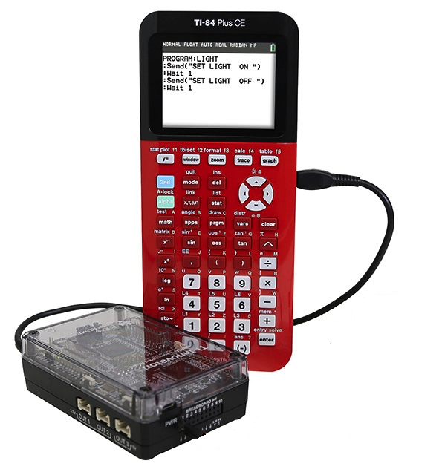
Introduction
Digital Mood Ring with TI-84 Plus CE and
TI-Innovator™ Hub student STEM project
Bring science and coding together (no coding experience necessary) while developing a mood ring! The science of color mixing is explored while determining the right body temperature thresholds.
The project includes variables, loops, conditional statements, Boolean operators and other fundamental concepts in programming

Slide 2
Recommended Path for TI-Innovator™ Projects
Smart Irrigation Project
Pet Car Alarm
10 Minutes of Code
for TI-Innovator™ Hub
Units 1-3
Digital Mood Ring Project
Four Chambered Heart
Music with Code
More in the works…

Slide 3
TI-84 Plus CE Resources:
Step-by-Step YouTubevideos designed for the teacher with a detailed, demonstration of each challenge.
The videos are intended to guide those new programming in general, programming on the TI-84 Plus CE and programming with the TI-Innovator Hub.
  https://www.youtube.com/playlist?list=PL17Fe0ZmhCR-PAuv5pw85vxrtLu5YGeWl
10 Minutes of Code with TI-Innovator:
https://education.ti.com/en/activities/ti-codes/84/10-minutes-innovator
10 Minutes of Code Teacher’s Lounge (TI-84 Plus CE): Select link to download zip files with PDF’s of all of the 10 Minutes of code lessons, teacher and student documents.
  https://education.ti.com/en/activities/ti-codes/84/teacher-lounge
TI-Innovator Technology eGuide
  https://education.ti.com/html/webhelp/EG_Innovator/EN/index.html
TI-Innovator Hub Commands
  https://education.ti.com/html/webhelp/EG_Innovator/EN/content/eg_innovsys/resources/pdf/ti-innovator_hub_commands_en.pdf
TI-84 Plus CE TI-Basic Programming Guide
  https://education.ti.com/html/webhelp/EG_TI84PlusCECode/EN/index.html
TI-84 Plus CE Reference Guide
  https://education.ti.com/html/webhelp/EG_TI84PlusCECode/EN/index.html

Slide 4
Digital Mood Ring Challenges
Challenge 1: Use SET COLOR to explore using the color LED. Try to find the RGB values of all the colors in the mood chart.
Challenge 2: Use DispAt command to display your name at several locations on the screen.
Challenge 3: Use a For..EndFor loop to display the numbers 1 through 10.
Challenge 4: Connect a temperature sensor to the TI-Innovator Hub and display the temperature on the calculator.
Challenge 5: Use a loop to read and display temperature.
Challenge 5 Extension (Optional): Use a loop to read, display and log into list arrays for time and temperature. Graph the result.
Challenge 6: Use a While..End loop along with getKey function to monitor temperature and make a decision to display a message, “Hot” or “Cold”. Then modify your program to include a 3rd level between hot and cold, “Nice”.
Final Challenge: Build a mood ring to repeatedly read the temperature sensor, determine the mood of the person, display the temperature value and display the mood.
Use “Digital Mood Ring by challenges” document at URL http://bit.ly/2GBIsUN

Slide 5
Summary of programming concepts in the project
Control of a red-green-blue LED output
  Send(“SET COLOR 255 0 0”)
Display of text strings, variable values and expressions
  Output(4,1,“TIME (SEC) =“)
  Output(4,13,N*0.5)
For loops to repeat a set of commands a specified number of times
  For(N,1,10)
  commands within loop
  End
Connecting, reading and getting to a variable temperature sensor inputs
  Send(“CONNECT TEMPERATURE 1 TO IN 1”)
  Send(“READ TEMPERATURE 1”)
  Get(T)
Storing variables to variables using the store operator.
  9/5 x T+32➔F
List variables of a set of values and accessing individual elements of the list using the position number.
  {0.5,1,1.5,2}➔L₁
  2.5➔L₁(5)
  True/False comparison operators used in conditional statements for program control: =,≠,<,≤,>,≥
Assignment of initial values to variables to give the program known starting points.
  0➔K
  0➔dim(L₁)
While loops to repeat a set of commands while a condition is true
  While K≠45
  commands within loop
  End
Keyboard inputs using the TI-84 Plus CE getKey command that returns a two-digit number for the row and column (top left key, y=, is 11) of the last key pressed.
  getKey➔K
If-Then conditional statements that do a set of commands if a condition is true and are skipped if the condition is false
  If T<22
  Then
  commands within If-Then block
  End
Boolean operator and to require two conditional statements to be true for the entire statement to be true
  If T≥22 and T<25
  Then

Slide 6
Summary of TI-84 Plus CE concepts and skills
ON starts at the home screen. The home screen is used for calculations, running programs and for program display commands.
2nd Quit will return you to the home screen from any situation on the calculator.
Select from menus using arrow keys and enter or by the shortcut of the number or letter preceding the menu item
clear key to back out of menus and dialogues
The keyboard is divided into three sections:
  Scientific calculator and math functions (bottom)
  Entry, navigation and setup (middle)
  Graphing and function keys (top)
Press and release the 2nd key to access function labeled above the keys. The input cursor changes to an up arrow to indicate 2nd entry mode. Press the 2nd key again to toggle back to normal entry mode.
Press and release the Alpha key to access Alpha characters labeled above the keys. The input cursor changes to an Alpha to indicate Alpha entry mode. Press the Alpha key again to toggle back to normal entry mode.
The delete key deletes the character at the current cursor location.
2nd Insert sets insert mode to enter characters before the current cursor location. Insert mode is indicated by an underline cursor. 2nd Insert or arrow key toggles back to normal entry mode.
  Pressing the prgm key while on the home screen gives you options to select a program to run on the home screen, to edit an existing program or to create a new program.
  Editing a program or creating a new program puts you in the program editor. Pressing the prgm key while in the program editor brings up menus with programming functions.
  Alpha f5 while in the program editor brings up a menu of editor tools, including copy, paste and insert line and execute program.
  2nd Quit while in the program editor exits the editor and returns you to the home screen.
  The Sto➔ key stores values to variables.
  The calculator has single variable values of A-Z and Θ and list variables of L1 and L6.
2nd catalog brings up a list of the functions of the calculator.

Slide 7
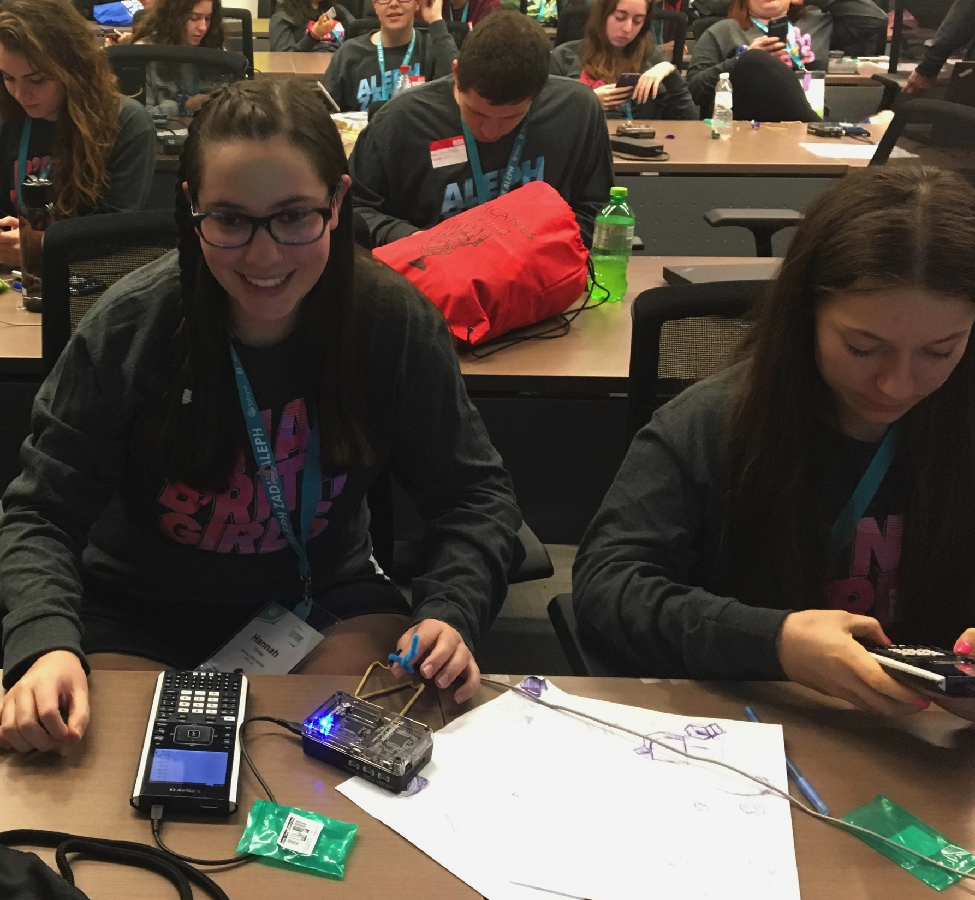
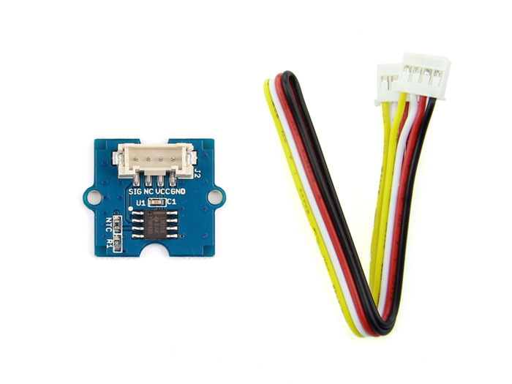
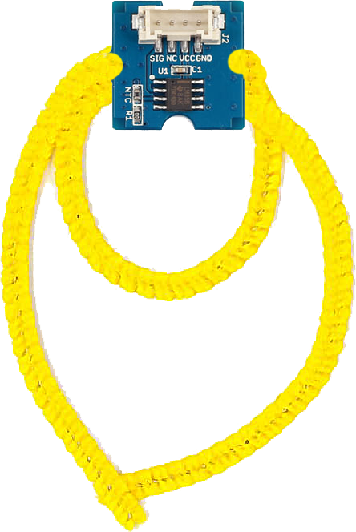
Digital Mood Ring (introduction to STEM and coding Projects for all levels)
Bring science and coding together (no coding experience necessary) while developing a mood ring! Explore the science of color mixing while determining the right body temperature thresholds.
This is an excellent first TI-Innovator STEM and coding project. The project includes variables, loops, conditional statements, Boolean operators and other fundamental programming concepts.
Use “Digital Mood Ring by challenges” document at URL http://bit.ly/2GBIsUN

Slide 8
Final Challenge
Digital Mood Ring with TI-84 Plus CE and
TI-Innovator™ Hub student STEM project
Final Challenge: Build a mood ring to repeatedly read a temperature sensor, determine the mood of the person, display the temperature value and display the mood.
Use “Digital Mood Ring by challenges” document at URL http://bit.ly/2GBIsUN

Slide 9
Chenille Wire (AKA “Pipe Cleaner”)

Slide 10
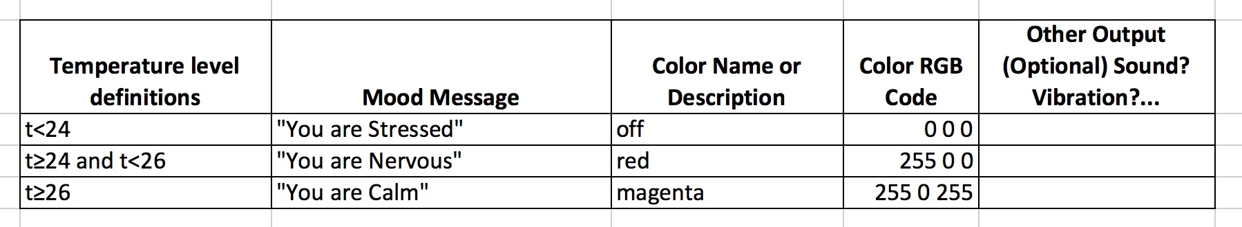
Defining your digital mood ring

Slide 11
Digital Mood Ring for TI-84 Plus CE
Simple Example Program
Send("CONNECT TEMPERATURE 1 TO IN 1”)
0➔K
Output(8,1,”PRESS CLEAR TO QUIT”)
While K≠45
getKey➔K
Send("READ TEMPERATURE 1”)
Get(T)
Output(4,1,”TEMP(°C)= ”)
Output(4,11,T)
If T<24
Then
Send("SET COLOR 0 0 0”)
Output(5,1,”YOU ARE STRESSED”)
End
If T≥24 and T<26
Then
Send("SET COLOR 255 0 0”)
Output(5,1,”YOU ARE NERVOUS ”)
End
If T≥26
Then
Send "SET COLOR 255 0 255”
Output(5,1,”YOU ARE CALM ”)
End
Wait 0.5
EndWhile
Send "SET COLOR 0 0 0”

Slide 12
Digital Mood Ring for TI-84 Plus CE
Simple Example Program
Send("CONNECT TEMPERATURE 1 TO IN 1”)
0➔K
Output(8,1,”PRESS CLEAR TO QUIT”)
While K≠45
getKey➔K
Send("READ TEMPERATURE 1”)
Get(T)
Output(4,1,”TEMP(°C)= ”)
Output(4,11,T)
If T<24
Then
Send("SET COLOR 0 0 0”)
Output(5,1,”YOU ARE STRESSED”)
End
If T≥24 and T<26
Then
Send("SET COLOR 255 0 0”)
Output(5,1,”YOU ARE NERVOUS ”)
End
If T≥26
Then
Send "SET COLOR 255 0 255”
Output(5,1,”YOU ARE CALM ”)
End
Wait 0.5
EndWhile
Send "SET COLOR 0 0 0”
Setup
Inputs
While Loop
Outputs
Clean up

Slide 13
On to the final challenge
Digital Mood Ring with TI-84 Plus CE and
TI-Innovator™ Hub student STEM project
Use “Digital Mood Ring by challenges” document at URL http://bit.ly/2GBIsUN

